Slide 1
The fear and the challenges of returning to Afghanistan
Arne Strand, CMI

Slide 2
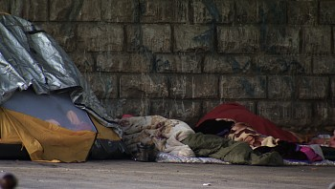
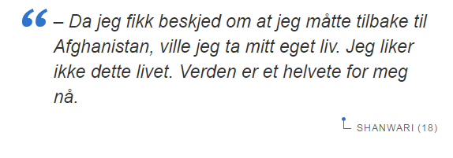

Slide 3
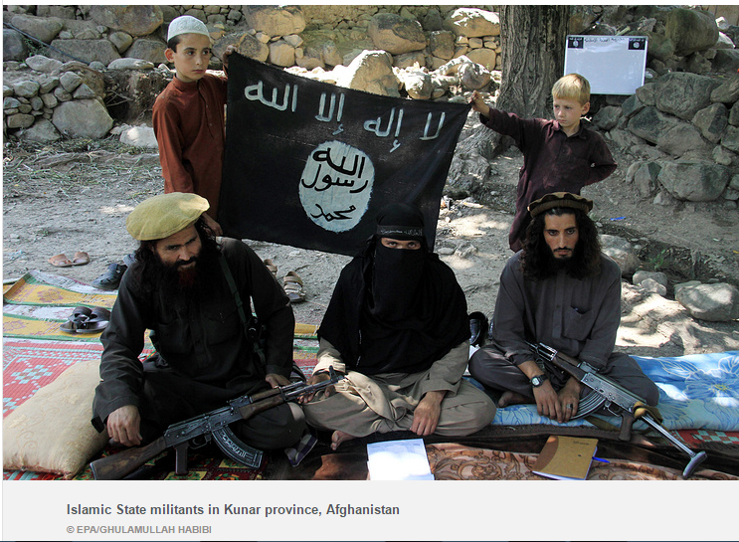
Red: Taliban control Yellow : dispuuted The New York Times|Source: The Long War Journal

Slide 4
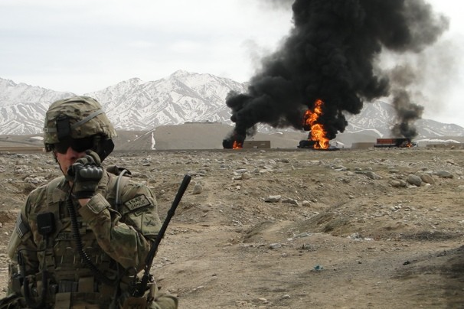
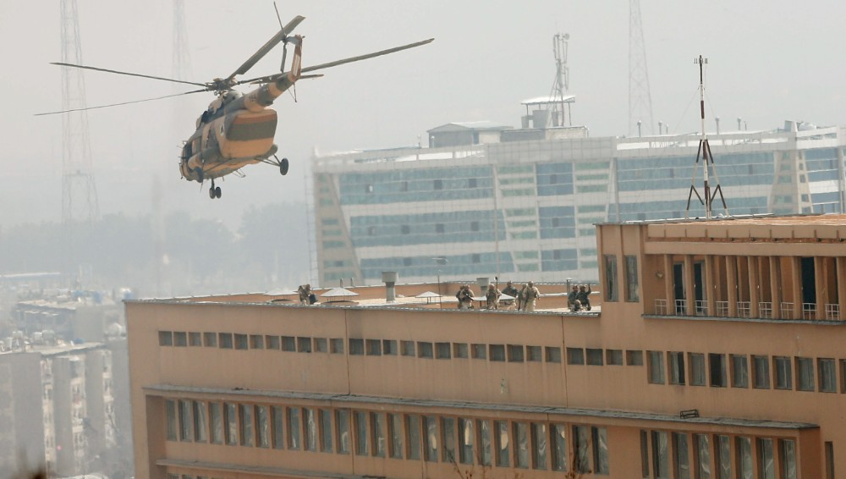
February 2017
Geographically, Kabul province had the highest number of civilian casualties due to suicide and complex attacks in Kabul city, followed by Helmand, Kandahar, Nangarhar and Uruzgan provinces.

Slide 5
Political stalemate, weak governace and economic decline

Slide 6
Youth unemployment, 40 %

Slide 7
0,6 million Afghans returned from Pakistan in 2016, and they keep on coming

Slide 8
Pressure on land and jobs, especially in Nangarhar
Pressure on access to land and jobs in Afghanistan
Increase in land disputes
Loss of income and remittences for many families
And, fewer job opportunities for returnees
As the number of returnees from Pakistan has increased, the chances of getting work has gone down. Some labourers told AAN that they had been waiting for weeks to get a single day’s work.

Slide 9
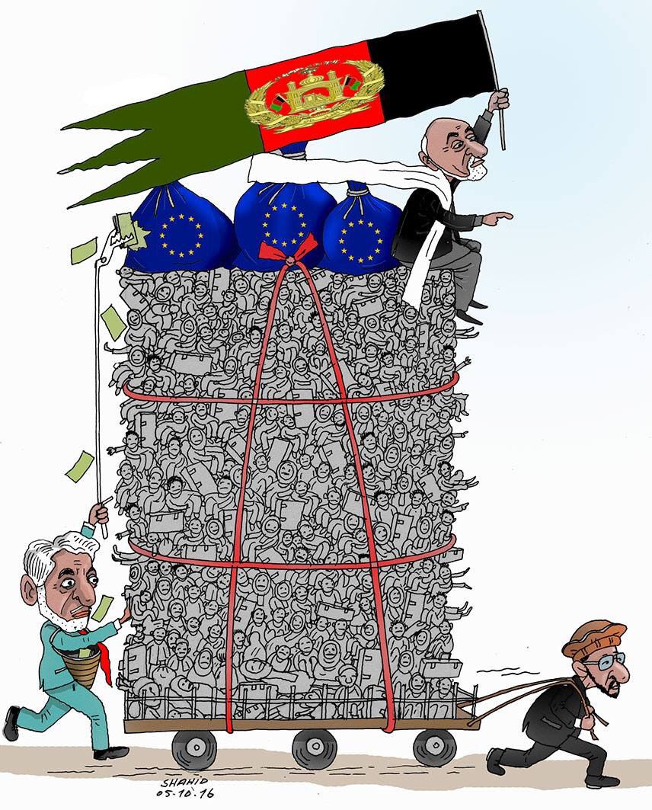
Internal differences on the Joint Way Forward return agreement with Europe

Slide 10
Many that return plan to remigrate – for the same reasons they originally left

