Slide 1
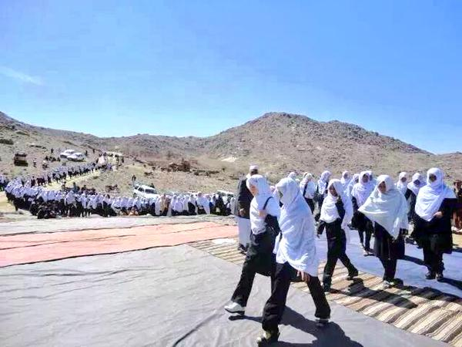
Girls’ education in conflict and emergencies, case Afghanistan
23.06.2015

Slide 2
Numbers and challenges
A major increase of children in school since 2001
Major inequalities, only 21 % of the girls complete primary education – rural/poor girls most vulnerable
Three main factors influencing girls education:
  Security, access to schools and qualified teachers
  Cultural and religious attitudes/ practises
  Governments ability to organise and mobilize for education

Slide 3
Numbers
MOE report 8.35 million students (39% of which are girls) in primary, lower secondary, and upper secondary government schools, including Islamic schooling, out of a school-aged population of 10.33 million.
1.55 million students may be absent or have dropped out of school.
3.3 million children, the majority girls, reported to be out of school.

Slide 4
Number games and funding
Ministry of Education:
“There are serious doubts on the accuracy of Afghanistan’s educational data: data are based on school principals’ self-reporting and principals tend to inflate enrolment figures because enrolment data are used for resource allocation, and still there is not a verification system in place.”

Slide 5
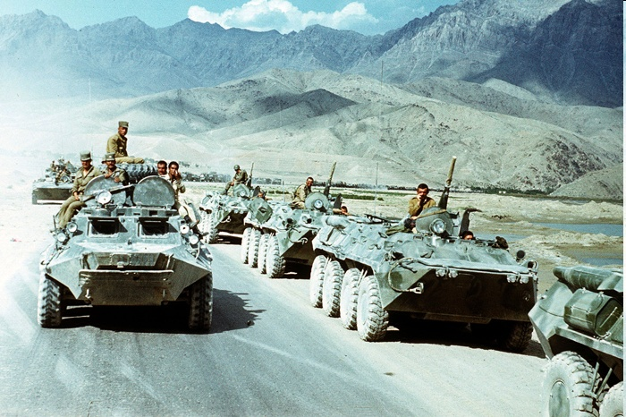
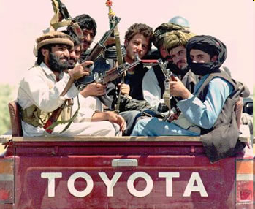
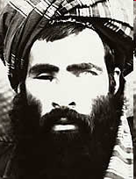

Wars -1979 – 2001

Slide 6
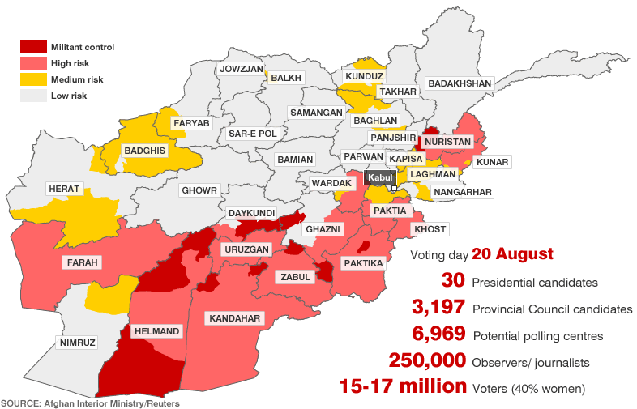
Warfare and geography

Slide 7
Inequalitities
Afghanistan has the highest level of gender disparity in primary education in the world, with only 71 girls in primary school for every 100 boys. Only 21% of girls complete primary school.
58% of boys and 52% of girls in urban areas attend school, while in rural areas only 41% of boys and 28% of girls attend.
80% of the richest boys in urban areas completed primary school in 2011, while the same was true for only 4% of the poorest girls living in rural areas.

Slide 8
Security & infrastructure
In 2012, 553 schools (almost 10%) with 275,000 students were closed due to insecurity, and the number is probably higher today.
Only half of government schools operated from dedicated school buildings; the rest are in open areas, tents, mosques, and private houses.
Around 30% of the schools lack safe drinking water, 60% lack sanitation, and about 31% are running on multi-shifts.
About 2.5 million children in primary school age do not have access to school within two kilometers distance

Slide 9
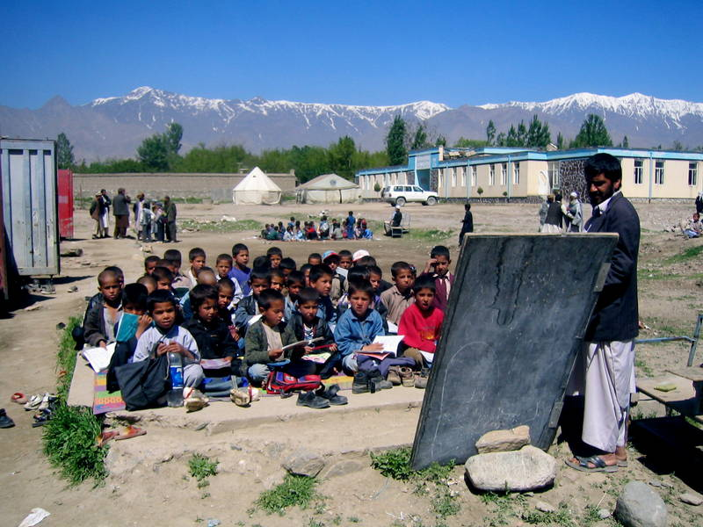
50 % of schools without a building

Slide 10
  Cultural and religious attitudes/ practises
According the MOE, cultural barriers are the primary reason that girls do not attending school and/or that their parents do not allow them to do so.
“some 46% of Afghani women are married by age 18, 15% of them before age 15.”
Shortage of female teachers. Only 31.7% of teachers and 17.4% of primary school teachers are women.
Lack of facilities and surrounding walls leave girls feeling vulnerable and prevent them from wanting to attend school.

Slide 11
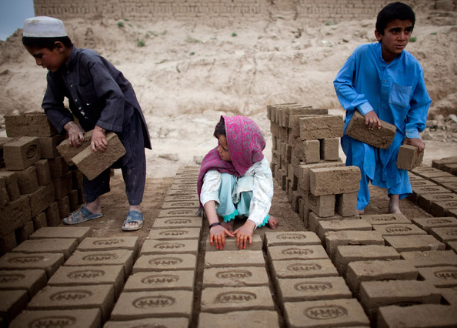
Poverty
21% of Afghan children (about 1.9 million) aged 6-17 years are working, and of these 13% can be classified as child labors.

Slide 12
  Governments ability to organise and mobilize for education
The MOE: their internal inefficiencies are “also, to a large degree, associated with inadequate technical capacities in the administration
Extremely high corruption rate and the prevalence of nepotism for political appointments in governance structures
Heavy dependence on external technical assistants has left MOE staff underdeveloped, as many of these experts “are leading activities rather than developing the capacity of civil servants.”

Slide 13
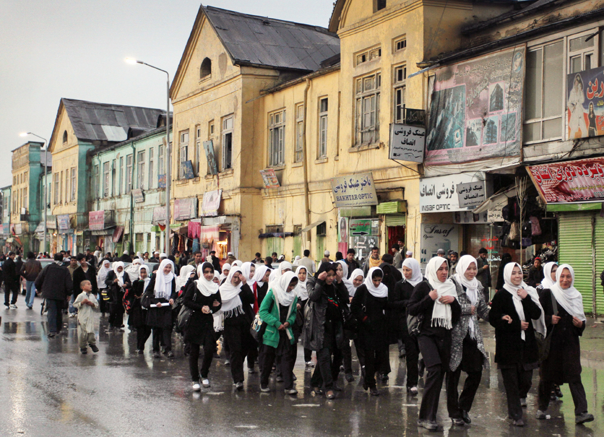
Schoolgirls in Kabul

Slide 14
Low quality
“By most standards, the education quality in Afghanistan is very low. Learning outcomes are generally poor. A few sample studies suggest that about less than half of the children are able to meet the minimum required learning outcome at their level of study.”
Only 43% of the teachers meet the minimum qualification requirements to teach at all levels. Most of those who are qualified seek to teach in urban schools, leaving rural areas with a pool of unqualified teachers – and very few female teachers.

Slide 15
Expenditure projection – baseline (WB)

Slide 16
What should be prioritized
Strengthen and develop teacher training, increase the number of qualified teachers, and assess if and how the NGOs and CBOs might take on a larger role.
Strengthen the MOE, specifically data and coordination efforts and to create mechanisms for competency-based hiring
Build a domestic resources and support base, and ensure a dialogue with local communities on their role in resource mobilization and support for education.

Slide 17
dilemmas
Lack of verify data, can it be supplemented/verified?
When and how do girls feel safe in school, protected by security forces or by communities? Is home/mosque schooling an alternative
How important is teaching methodology for the quality of education?
How (and by whom) to address cultural practises and religious beliefs?

