Slide 1
Civil Society in Peacebuilding, What room is there for Diaspora participation?
Arne Strand

Slide 2
What is civil society?
…the arena outside of the family, the state, and the market where people associate to advance common interests
Abroad or narrow definition, not always positiv!
Local, national and a transnational civil society

Slide 4
What does war bring? What I have seen:
Destruction, death and grief
Physical and menthal wounds
Divided societies
Eroded trust and change of norms
Lack of governance and rule of law
War business… for some
Migration and diaspora communities

Slide 5
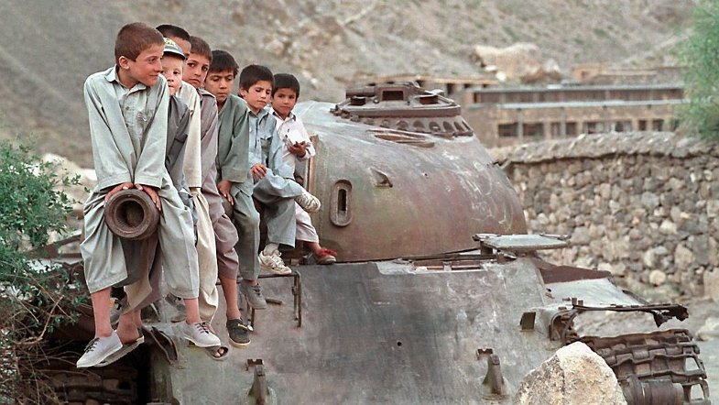

Slide 6
What is peacebuilding? Chic Dambach, Alliance for Peacebuilding
Peacebuilding is the set of initiatives by diverse actors in government and civil society to address the root causes of violence and protect civilians before, during, and after violent conflict.
Peacebuilders use communication, negotiation, and mediation instead of belligerence and violence to resolve conflicts.
Effective peacebuilding is multi-faceted and adapted to each conflict environment. There is no one path to peace, but pathways are available in every conflict environment.
Peacebuilders help belligerents find a path that will enable them to resolve their differences without bloodshed.
The ultimate objective of peacebuilding is to reduce and eliminate the frequency and severity of violent conflict.

Slide 8
What influence might civil society hold?
Setting norms, make the world safer: Campaigns to Ban Land Mines and cluster ammunition, R2P
Research, information, political support , sustained international campaigns – with local organisations
Providing pressure, ie HR violations –
combine facts/information with political pressure
Establish linkages : building national capacity
Networks of peace organisations, training, exposure…

Slide 9
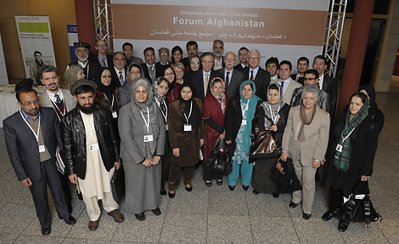
Setting the frame – influencing negoitiations ?

Slide 10
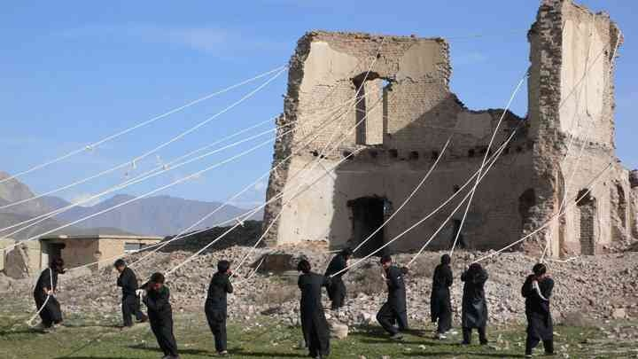
Generating humanitarian/peace space – Aceh and Kabul

Slide 11
Reducing conflict potential (more than do no harm)

Slide 12
Common pain – common peace Families of missing persons in Cyprus

Slide 13
Truth and reconciliation commissions Museum of Memory and Human Rights, Santiago, Chile.

Slide 14
WAR DIASPORA
often divided in longlasting conflict– represent parties/diving lines of the same conflict as at home
represent diverging views in host country, –if not suppressing other views
generates financial support for warring parties or for peace
”dogwasher” or ”agent of change”?

Slide 15
POSTIVE ROLES
can help inform and shape debates on particular conflicts and peacebuilding
can address their own conflict, search for and support positive peace
can contribute with human resources and knowledge in home country
Can ”work on the conflict” in host country

Slide 16
CHALLENGES…
Some conflict as intense internationally as in the country, and less willingness to compromise – personal identity built on conflict identity
Lack of unbiased knowledge of the conflict and how it has/is developing
Easier to disengage, create distance to the past
But, is social media reeneforcing rather than challenging the divining lines/conflict assessment?

Slide 17
QUESTION ON MY MIND…late evening in Kabul
Are we so focused on the negative aspects and the political games that we loose out on/don’t manage to identify, duplicate/reinforce the positive?

Slide 18
