Slide 1
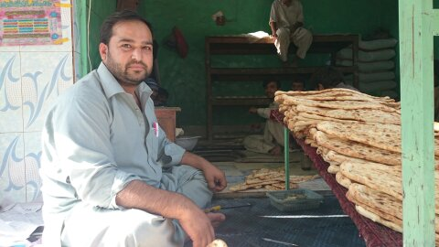
Afghan migration patterns: flight, return and remigration
Cyprus, 18.06.16

Slide 2
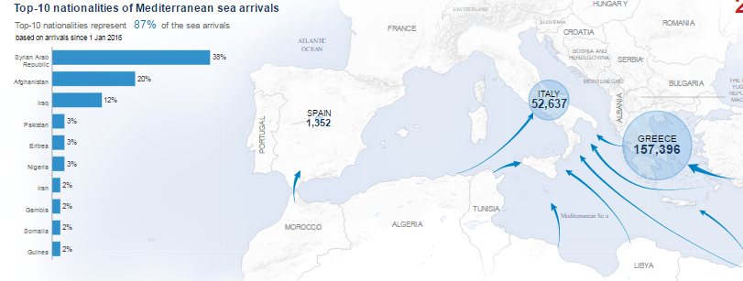

Slide 3




Wars -1979 – 2015

Slide 4
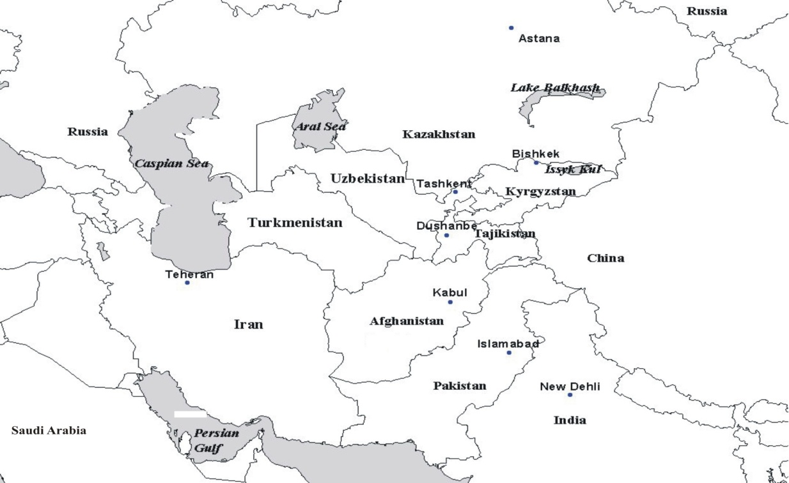
Regional migrasjon and flight

Slide 5
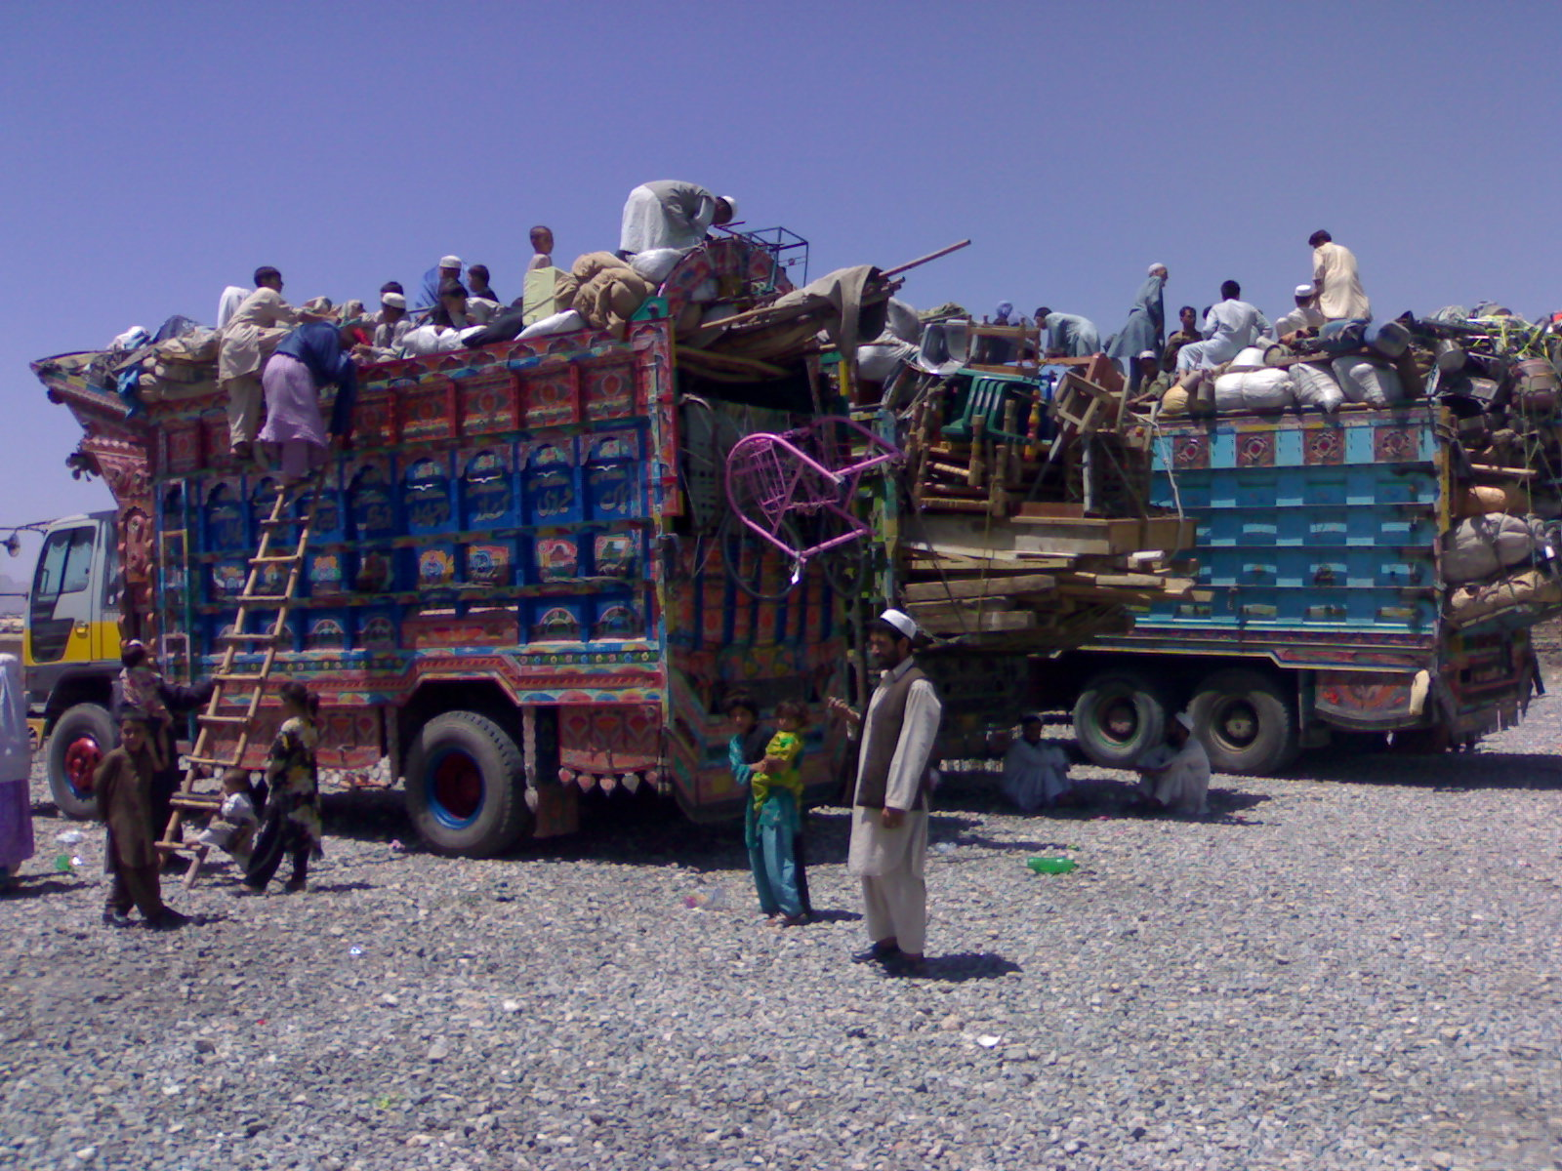
Return, waves 1991 (2 mill), 2002 (5mill) + assisted/forced return from Europe

Slide 6
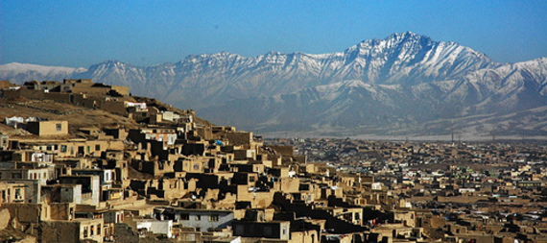
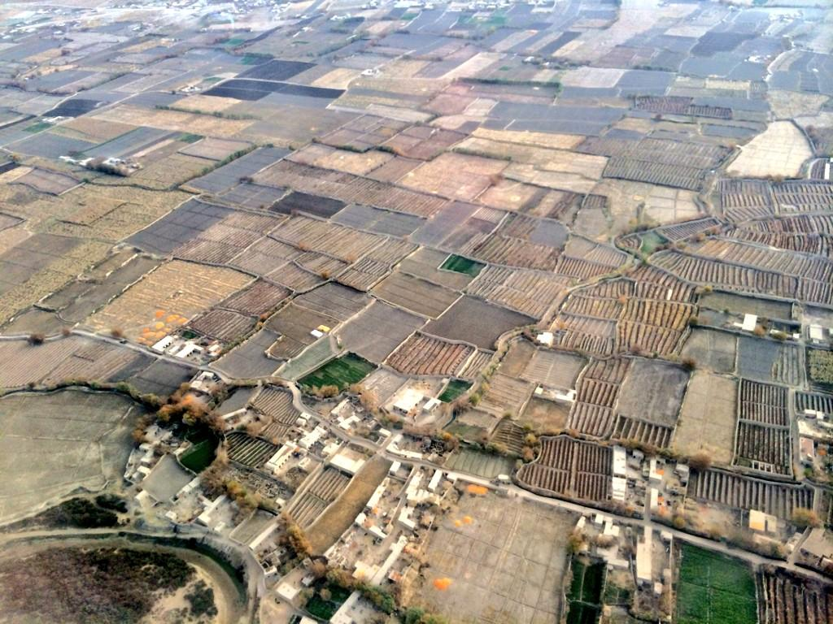
Land disputes and urbanisation
NATIONAL
IN FAMILY
Mixed:
good to have you back,
why did you waste our money

Slide 7
Ethnicly divided Kabul

Slide 8
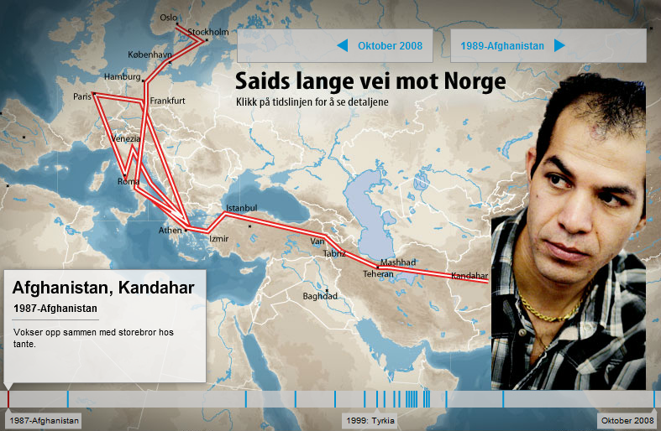
Why Norway?
Due to lack of personal security
The majority did not actively select Norway as their destination, they went for “Europe” and then they followed advise from smugglers or «friends on the road»
Most by land-route through Iran and Turkey, some through Russia, some worked their way
Many Afghans left from Pakistan and Iran, many under 18

Slide 9
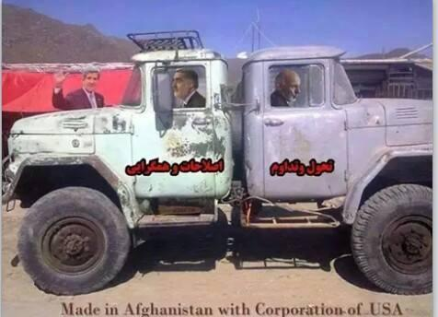
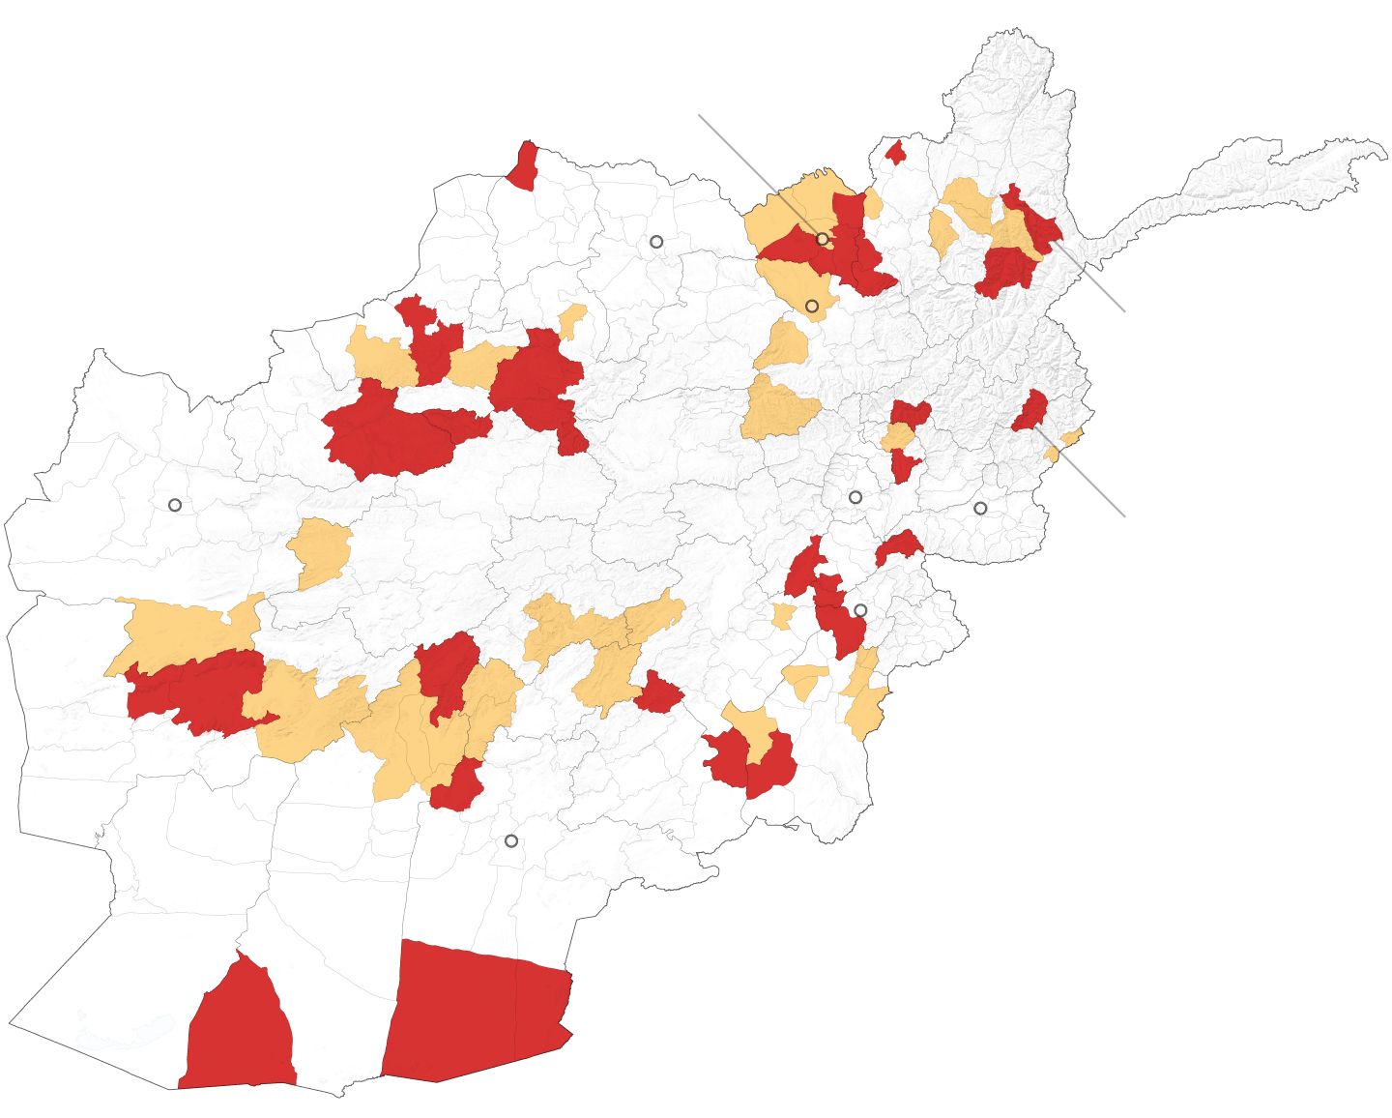

Why leave now?

Slide 10

Assited return
Return travel
Cash at arrival
In kind (for 6 months)
  business-startup
  Job placement
  Education
  Possibly houserent, etc

Slide 11
Mental point of return
Most made the decision to return after coming to the point where there was no other alternative – which also meant that it was not considered as a choice between other options.
This mental point of return could have been triggered by something happening in the country of origin or as the consequence of a mental turnaround.
All who planned to return had come to the conclusion that continuing their stay in Norway no longer constituted a viable alternative…

Slide 12
Business option

Slide 13
«should I stay or should I go»

Slide 14
Program advantages, in contrast to answers inNorway

Slide 15
Four contributing factors to determine success or failure of reintegration:
The economic and security situation in the area of return, which influences general economic prospects and the ability to secure an income over time;
The professional skills and management experience/ability of the returnee;
The availability of family (and good relations with the family) in the country of origin (this might be an important contributing factor for lasting reintegration); and
IOM/ARRA’s role in providing evidence-based advice on selecting the most appropriate type of in-kind assistance (and type of business) and providing mentoring during the start-up phase when there are indications that the business or job placement might fail.

Slide 16
Type of returnee | Post-return characteristic
Those who aspire for reintegration and are able to reintegrate | Sustainable return
Those who aspire for reintegration but are unable to reintegrate | Volatile return
Those who do not aspire for reintegration, but are unable to re-migrate | Unsustainable return
Those who do not aspire for reintegration and are able to re-migrate, either back to the country of previous settlement or elsewhere | Re-migration

Slide 17
Questions
Can return to insecure areas/weak economy be sustainable – or will it lead to remigration for the majority?
Can some type of external assistance increase sustainability – individual or community orientation?
Can external/development assistance prevent – outmigration?
What might massive forced return from Europe imply for the middle east region?

Slide 18


