Slide 1
Beyond Conflictual Peacebuilding
Case: Afghanistan
Arne Strand
1.11.2014

Slide 2
Conflictual peacebuilding defined
A peacebuilding process where in a phase of a civil war the parties to the conflict position themselves to shape the critical aspects of the post-war order, that is:
The structure of the state
The nature of society
The role of the military
Astri Suhrke, Kristian Berg Harpviken and Arne Strand (2004)

Slide 3
Issues
An imposed or embraced peacebuilding model?
Democratisation and the role of the President
Security and the rule of law (incl informal justice)
Development assistance
Women and influence
Peace-negotiations
Elections
Where are the Afghans now?

Slide 4
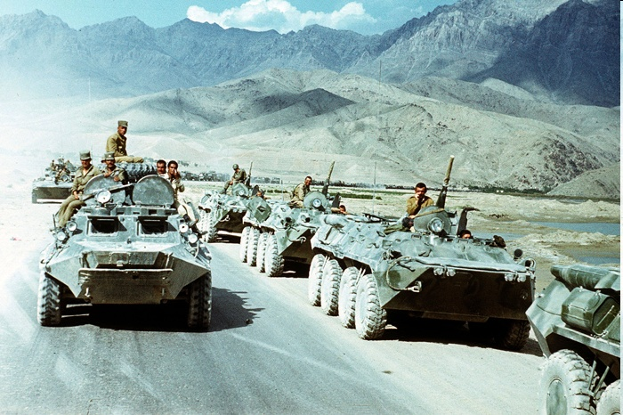
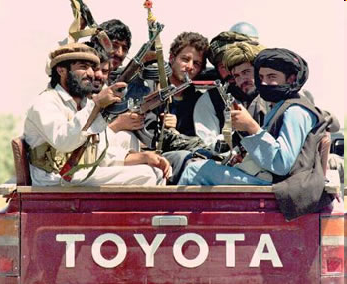
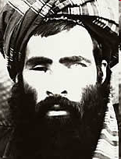
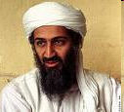
1979 – 2011
Ideology, religion, power
Cold war, regional proxy war and war on terror
Notes:
Coup de etait – 1973 and 1978

Slide 5
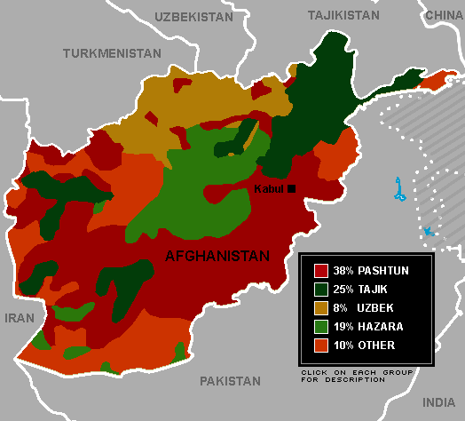
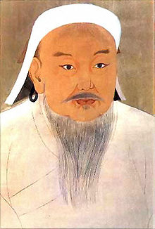
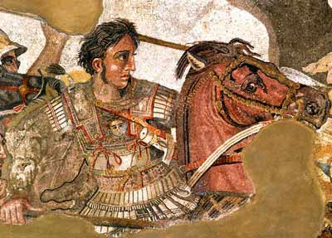
The ethnic & regional map

Slide 6
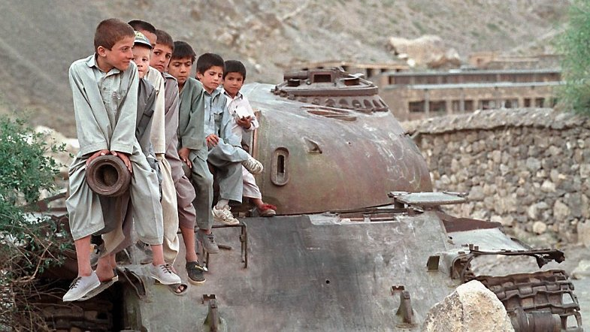

Slide 7
WINNERS TAKE IT ALL
THE BONN AGREEMENT NOVEMBER 2001
Mujaheen parties, US, EU, selected countries and individuals agree on a “peace agreement”
Taliban and other opposition parties excluded
The Pashtun Hamid Karzai appointed as Interim President
Formation of government with division of position between the political/military parties, later including some technocrats

Slide 8
Ambitious goals for the «new Afghanistan»
International political imperatives:
The ‘war’/struggle against terror
The wish to avoid large movements of refugees arriving in the donor countries
The struggle against organised, international crime, including the drugs trade
National political imperatives:
The introduction of Democracy into the recipient country, often equating to the creation of a new polity
The enforcement of respect for human rights
The promotion of gender equality
Economic imperatives:
The creation of an open market economy, integrated in the globalisation process
A corresponding lean and efficient state
The military imperative:
The use of armed forces and combined civilian-military activities (PRTs) activity to enforce peace and to create “space” for humanitarian, rehabilitation and development action

Slide 9
Afghans accepted the “new Afghanistan”, except Taliban…. but did not necessarily embrace it
MAINTAINIG (BUT MUTING) OPPOSITION AGAINS CHANGE, not officially against girls education or women in politics - but resisting change ( i.e. Parliament introducing laws that limit rights and representation) | ADAPTING CHANGE IN OWN FAVOR, and securing own influence – as the Parliament where 60 % had “connection to militant groups” – despite against the Election Law
MAXIMISING ECONOMIC OPPORTUNITIES, using positions in government for securing group/family business deals (security, oil gaz, state property, land grabbing) | MAXIMISING MILITARY STRENGT (FOR TOMORROW), though maintaining and developing military capacity of jihadi parties within the police and army

Slide 10
And got away with it
…because they were “needed” in the War on Terror
…threatened to disrupt security and development if not benefitting (enough)
… and fitted into an international military strategy for defeating Al Qaida and Taliban, needing:
- strong (and loyal) president without “organised democratic opposition”
- using development assistance to “buy loyalty”
- policy: “don’t rock the boat” (HR, war crimes..)

Slide 11
All power to the president
No Prime Minister
No political parties allowed to stand for election
Single Non Transferable Voting system, fragmenting the Parliament/Provincial Councils
(Still) no voter registration or national ID cards
Massive rigging of all elections, generation new conflicts and violence

Slide 12
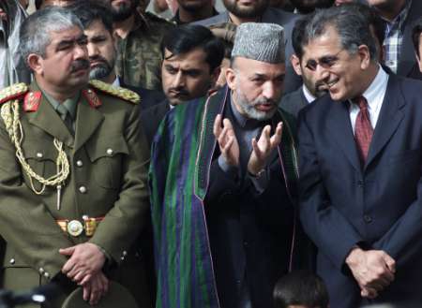
A balancing act

Slide 13
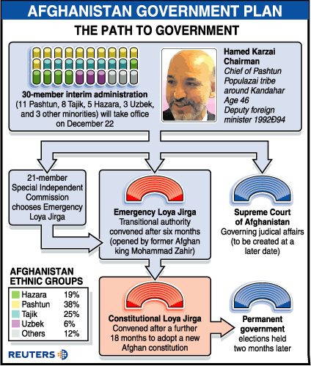
Notes:
5 years… for democratisation

Slide 14
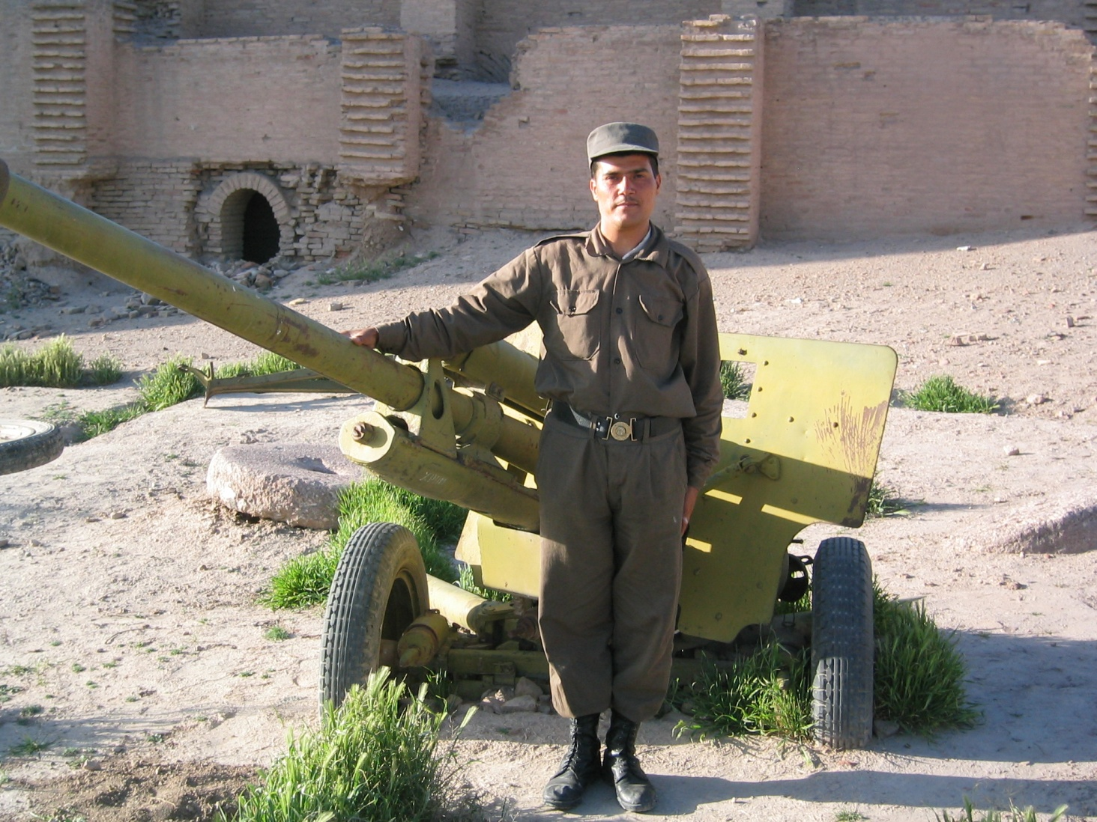
Security & war on Al Qaida and Taliban
Afghan Army: 300 000
Cost:5 x national budget
Afghan Police
Incl. Muhj groups
Afghan Local Police
Rearming the disarmed
Bilateral Security Agreement

Slide 15
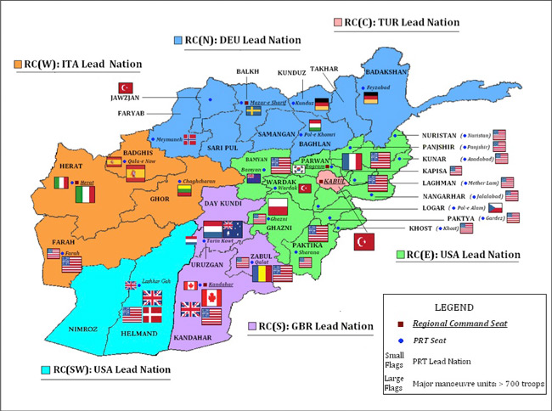
A «fragmented war on terror»

Slide 16
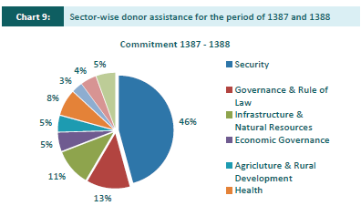
Development Assistance – primarily for security

Slide 17
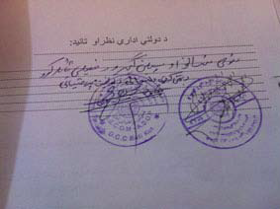
From Formal to Informal justice
“80 % of Afghans don’t trust the Judicial System”,UN report
To counter possible Taliban influence: support for INFORMAL/TRADITIONAL JUSTICE
Ops, that strengthened commanders
and reduced rights of women:
  “linkages between the formal and
informal”

Slide 18
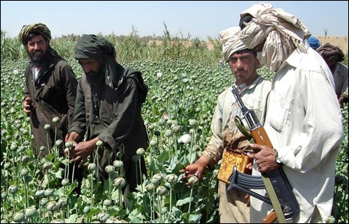
50 % of national budet, for whom?
Notes:
Benfitting all – including the GoA

Slide 19
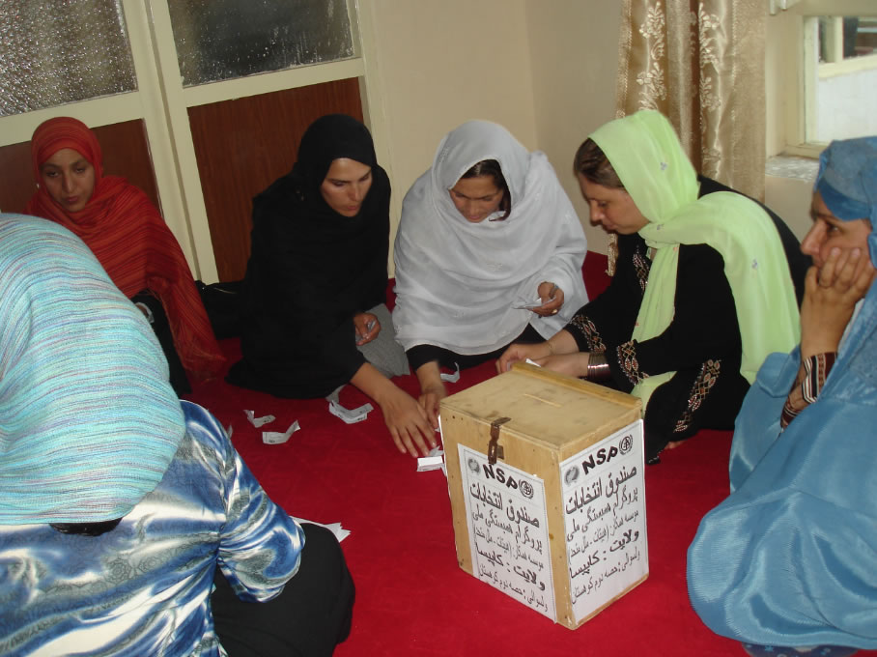
Women – limited political gain, but foundation laid for development

Slide 20
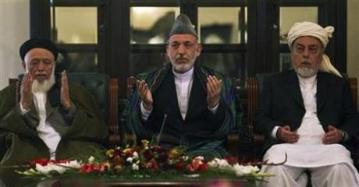
High Peace Council – peace negotiation & reintegration & «the peace business»

Slide 21
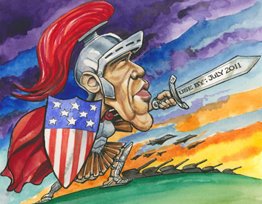

Slide 22
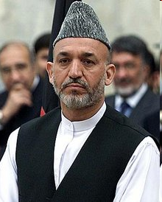
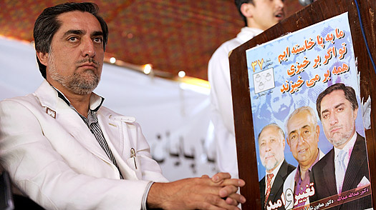
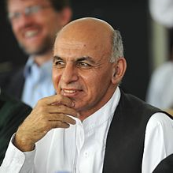
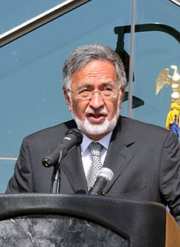
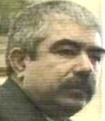
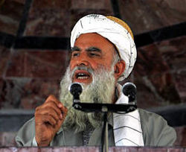
2014: Presidential/province elections, troop withdrawal and donors further committment

Slide 23
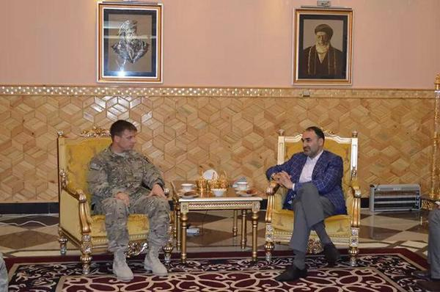
Threat of violence as bargening tool

Slide 24
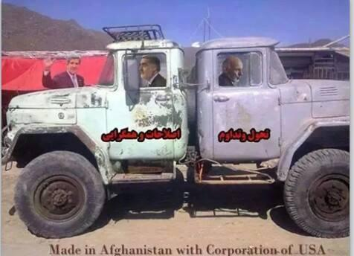
National Unity Government

Slide 25
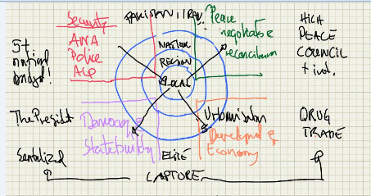
The model & how it worked – or not – for whom

Slide 26
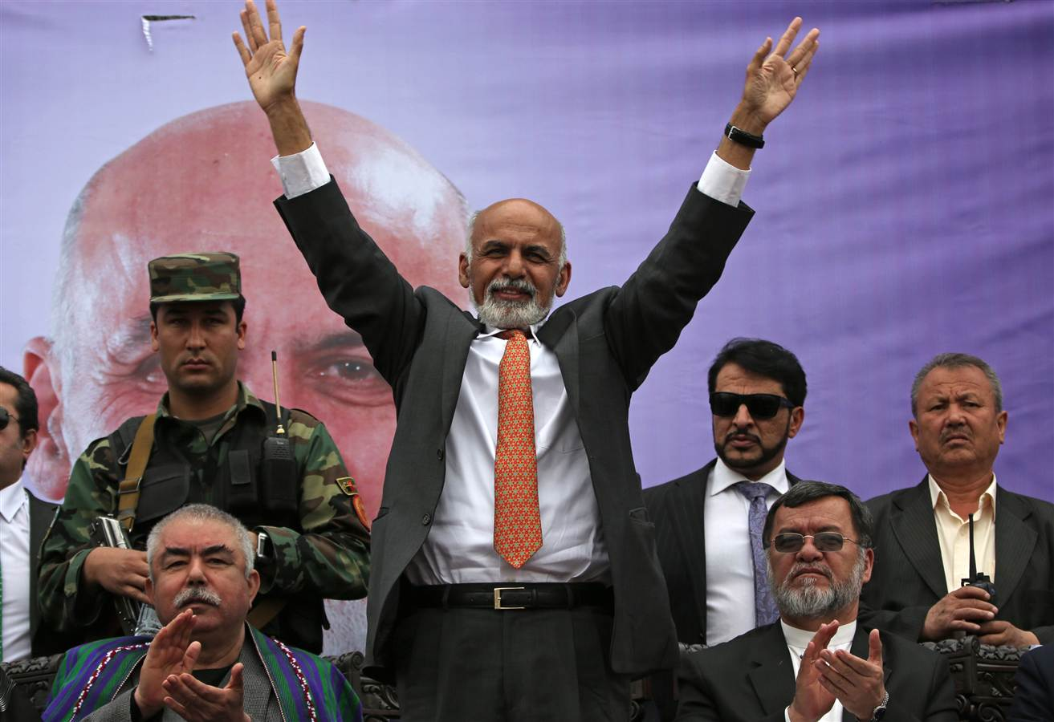
A new President: New opportunities?
Reconciliation or new conflict over power?

Slide 27
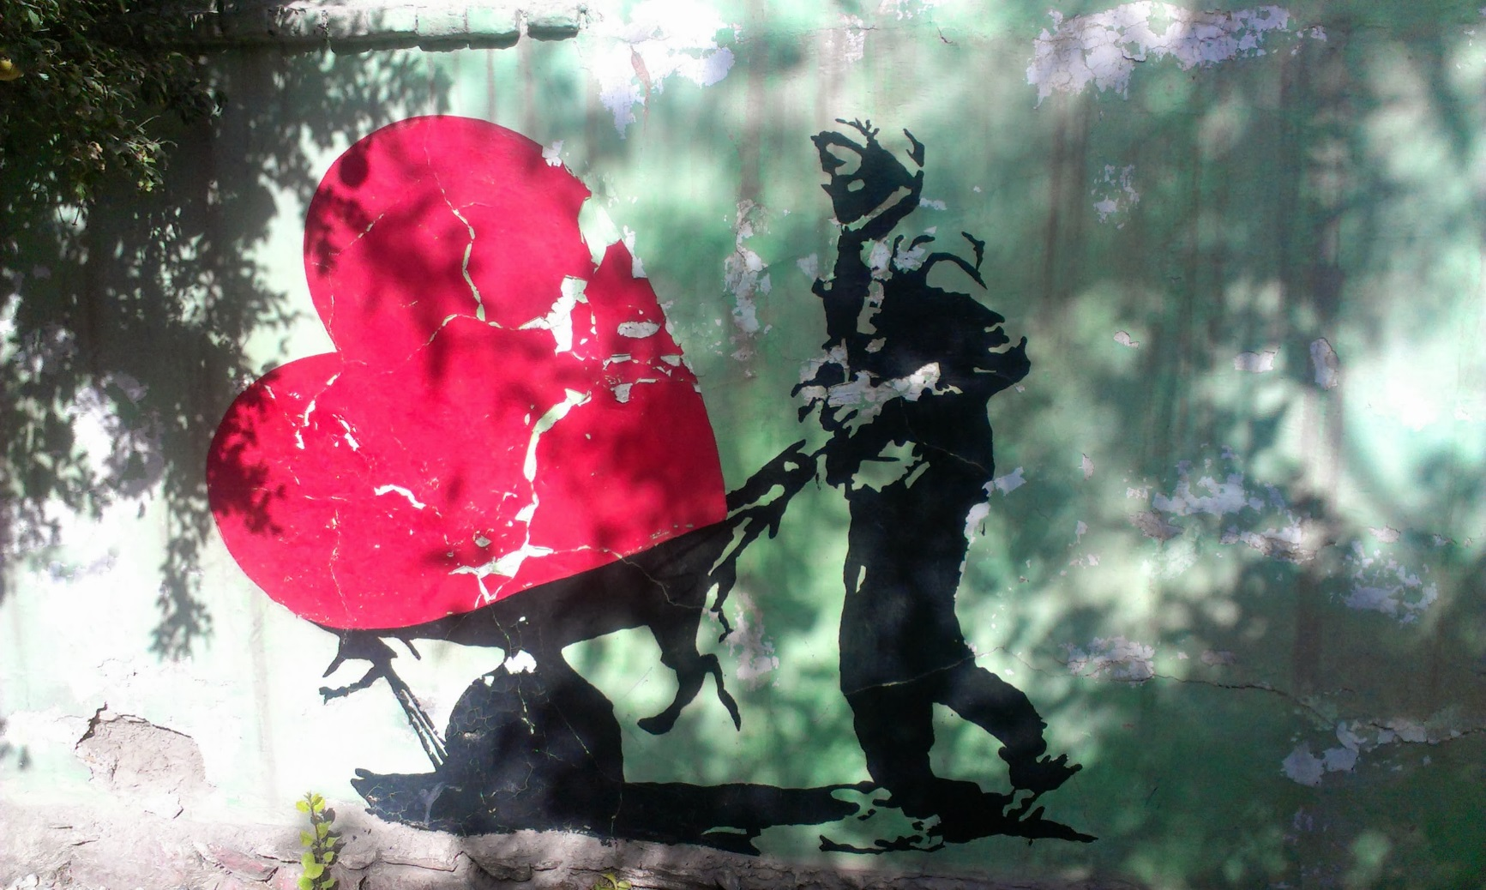
New voices – better educated and “twitterering”

Slide 28
Still challenging & still conflictual
Security deteriorating: Taliban, local police, drug mafia, local powerholders = civilian victims
International funding reduced (incl military), economy deteriorating
High degree of corruption (TI)
Pakistan still housing Taliban
(military) powerholders relucatant to give in

Slide 29
