Slide 1
Trusting Afghans their development
18.11.11
Arne Strand

Slide 2
Afghan development
Opportunity
Afghans want development – major unmet needs
Consultative decision making might secure ownership
Tradition for communal work/maintenance
Challenges
Limited funding and implementation capacity (and corruption) – ranked172 of 187 on UN HDI
Insecurity, limit access and staff security
Militarized strategies/priorities – target conflict areas

Slide 3
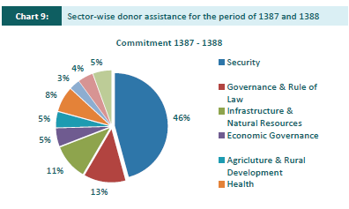

Slide 4
Insecurity – quality and manners matter
NGOS have seen a 73% increase in incidents since 2009, but there is no specific targeting of NGOs (ANSO)
Why valued (and nit targeted)?
Firstly, the NGO was seen to respond to the needs of the community and to engage the community before moving forward with any programmatic intervention;
Secondly, the quality of delivery was deemed to be very high and the NGO viewed as distinct from other organisations because they delivered on their stated promises;
Thirdly, the NGO was continually referred to as having a ‘good manner’ with the people (PTRO)

Slide 6
Winning hearts and minds
Research suggests that the failure to win Afghan hearts and minds is not because too little money has been spent. In fact, money has been part of the problem.
Spending too much too quickly with too little oversight in insecure environments is a recipe for fueling corruption, delegitimizing the Afghan government, and undermining the credibility of international actors.
Andrew Wilder, Tufts International Centre, 2009/10

Slide 8
