Slide 1
When breaking up is hard to do: Exploring exit strategies in Afghanistan
Arne Strand

Slide 2
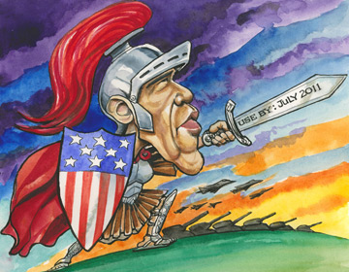

Slide 3
9 years of international engagement
Increased insecurity in large parts of Afghanistan, high military and civilian losses
Country second last on UN Human Development Index, despite major growth and external support – including for health and education
Low trust in Afghan government/institutions/ democratisation, rampant corruption
Increased ethnic and rural/urban tension

Slide 5
Scenarios
Rapid military withdrawal from 2011, followed by decrease/termination in external funding – ”leaving it all to the Afghans”
Gradual US military withdrawal from 2011, (almost) all NATO troops out by 2014 (US elections) – time for strategic planning of longer term dev/governance interventions
Planned military withdrawal, transfer to UN peacekeeping force, strategic longterm development planning and funding guarantees

Slide 6
Challenges, opportunities - 2014
Political negotiations – and stakeholder acceptance
Security – for all
Governance and ”state capture”
Rehabilitation and development
Human rights, incl rights of women

Slide 7
Negotiated peace

Slide 8
What is going on?
Afghan Peace Jirga convened summer 2010, gave acceptance for negotiations with Taliban/armed opposition
Peace Council appointed October 2010, tasked to negotiate a political settlement
Pakistani military key actor, influence on Taliban (especially Haqqani fraction)
US gradually warming up, while killing Taliban leaders (300 over the last 3months)
The game now: who are to control the negotiations?

Slide 9
Challenges
When is it a good time to negotiate? Can the Afghan government/NATO/ISAF strengthen their position, or is it better to negotiate now?
Fixed positions or room to negotiate, accept constitution versus all troops out?
Will Afghan ethnic minorities accept decreased influence, and can human/women rights be safeguard?
Is there a settlement all Afghan neighbours might accept?

Slide 10
Afghan security responsibility (Foto: ISAF)

Slide 11
Plans for security transfer
Afghan National Army (ANA) – aim 171,600 (by October 2011) – now 120 000
Afghan Police, aim 134,000 (by October 2011) – now 105 000
ISAF, under NATO command, scale down from approx 120, 000 today to ?, more focus on training
Arbaki, local defence forces, numbers ?

Slide 12
No way around, but when?
Afghanistan is a sovereign country. It is their armed forces. They eventually will have to take over security for their country”
Lt-Col Peter Benchoff
US Army
(BBC October 2010)

Slide 13
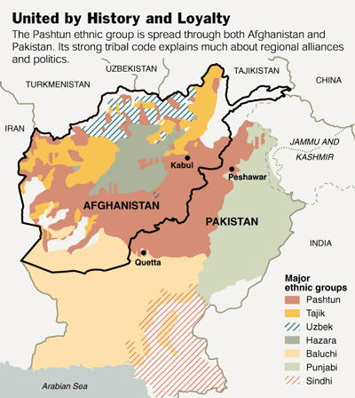

Slide 14
Challenges
Orientation, anti terror or “security for all”
Securing political control/loyalty of leadership
Quality of personnel, not only numbers
Ethnical balance
Arbaki, providing local security or insecurity
The role of the “narco state” & offical state
Regional security guarantees
Dependency on external funding

Slide 15
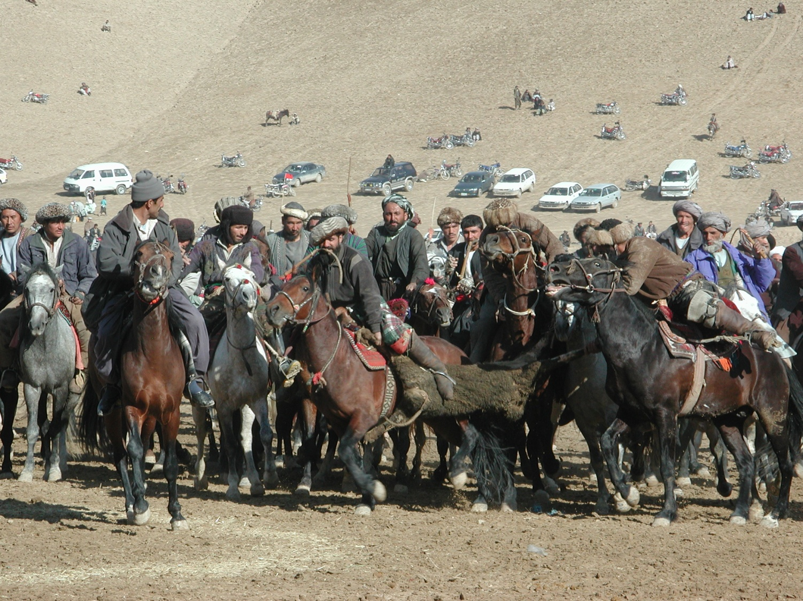

Slide 16
Governance and state capture

Slide 17
A lot is going on…. but negative focus
The quest for ”our” strong president has competed with Karzai’s need to build Afghan networks for own survival
All power (and money) in Kabul has generated local grievances
Uncertainty over future ends up in short term “looting” of state funds/property

Slide 18
State capture

Slide 19
Challenges
Shift funding from security to development
Willingness to support longterm building of government capacity and skills, not least at province and district levels
Decentralisation without “closing down the central state”
Encourage debates on governance structures, role/influence of elected bodies and political parties

Slide 20
Rehabilitation and development

Slide 21
More to report on…
Several government programmed (with NGOs) have increased no of schools, health clinics and community rehabilitation and development (NSP)
Reputed NGOs have maintained presence in most of Afghanistan, even during conflict
Support for agriculture is getting increasing attention
Small community investments can make major differences

Slide 22
Community development

Slide 23
Challenges
Very high Afghan expectations (and needs)
TO generate many more permanent jobs
To develop government capacity beyond Kabul
Quality teachers, health workers, development workers in demand
Secure neutrality for humanitarian assistance and professional development (hearts and minds don’t work)

Slide 24
Oil, gas and electricity (foto: Geir Ytreland)

Slide 25
Human rights and rights of women

Slide 26
Less to report on…
Continued violations of basic human rights
Transitional justice initiative overturned by Parliament providing themselves amnesty
Resentment against being ”taught western human rights”, more focus on Afghan values
Fear that a peace deal with Taliban by the Peace Council will overlook human and women rights

Slide 27
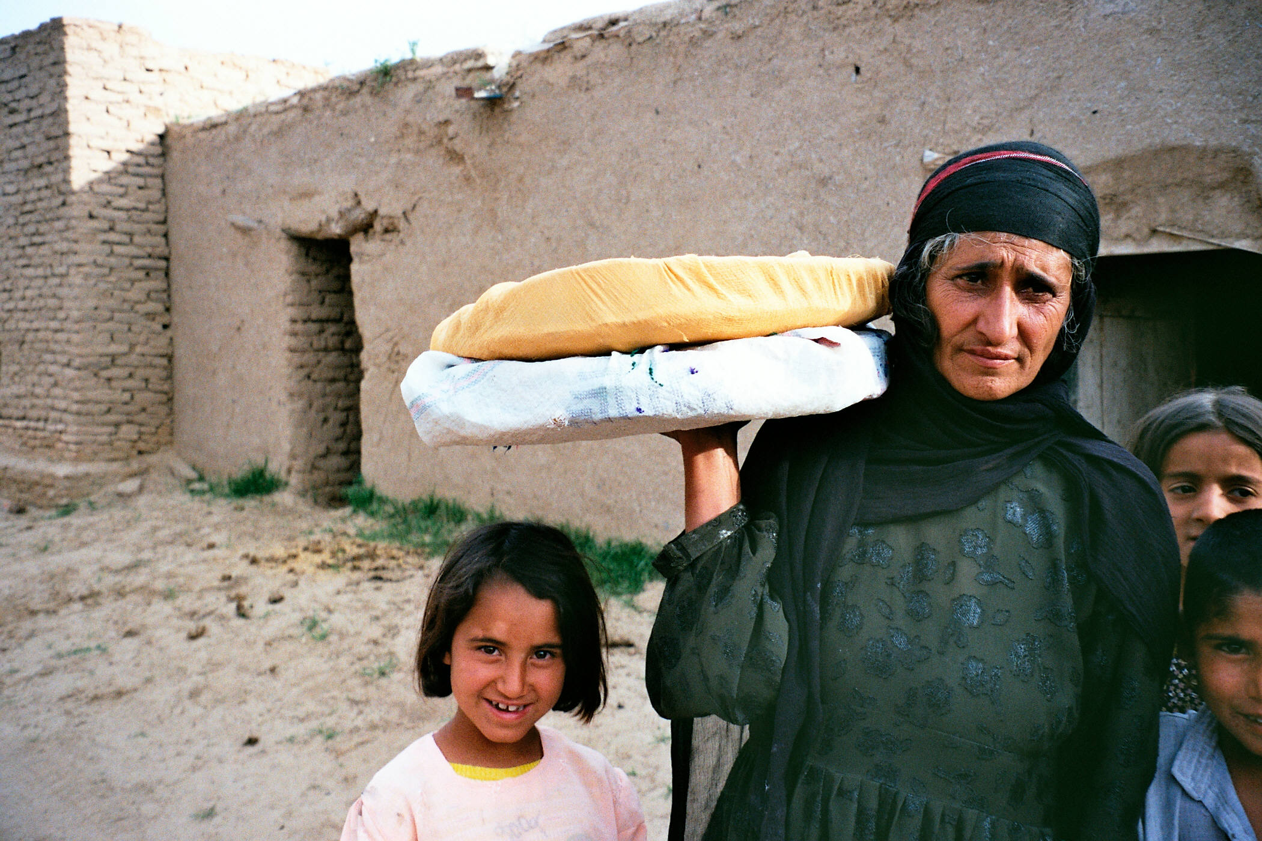

Slide 28
Challenges
Find ways to support Afghan women and advocacy organisations voices in the debate
Have military actors refrain from supporting the worst human rights violators (arbaki)
Human rights benefits of a negotiated settlement up against minimum requirements for HR respect in any deal

Slide 29
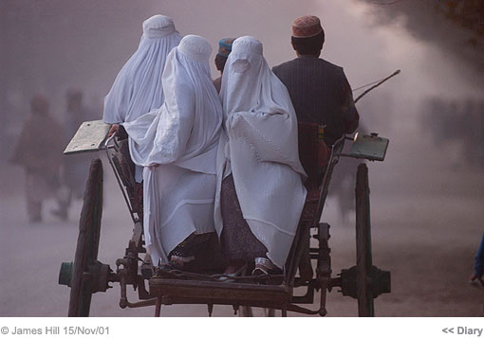

Slide 30
Leaving the Afghans to themselves, or…
A small (not US/UK/neighbours) international peacekeeping force to maintain security for a continued political process. Assess size, orientation and control over Afghan army and police
Increase support for development/rehabilitation in a Government/community partnership - prioritise jobs, education, health…
Intensified capacity building and higher education – and massive investments in rural economy/agriculture
Allow afghans to be more firmly in control of own development and democratisation, more community ownership and transparency
Accommodate concerns of neighbouring countries, help resolve conflicts over borders, water and natural resources
REQUIRES REDUCTION OF MILITARY INFLUENCE ON STRATEGIC PLANNING

Slide 31
