Slide 1

"NATO i Afghanistan: Fredsbevaring eller antiterroroperasjon?"
Arne Strand
CMI

Slide 2
Tema
Mandat og organisering, OEF, ISAF & NATO
Status – etter 8 år
Afghanistan/Pakistan – kontekst faktorar
- det pashtunske
- krigshistorikken
- sivile tap/ asymetrisk krig
Tillitskrisa, “utbre” ei regjering med liten støtte
Veien ut?

Slide 3
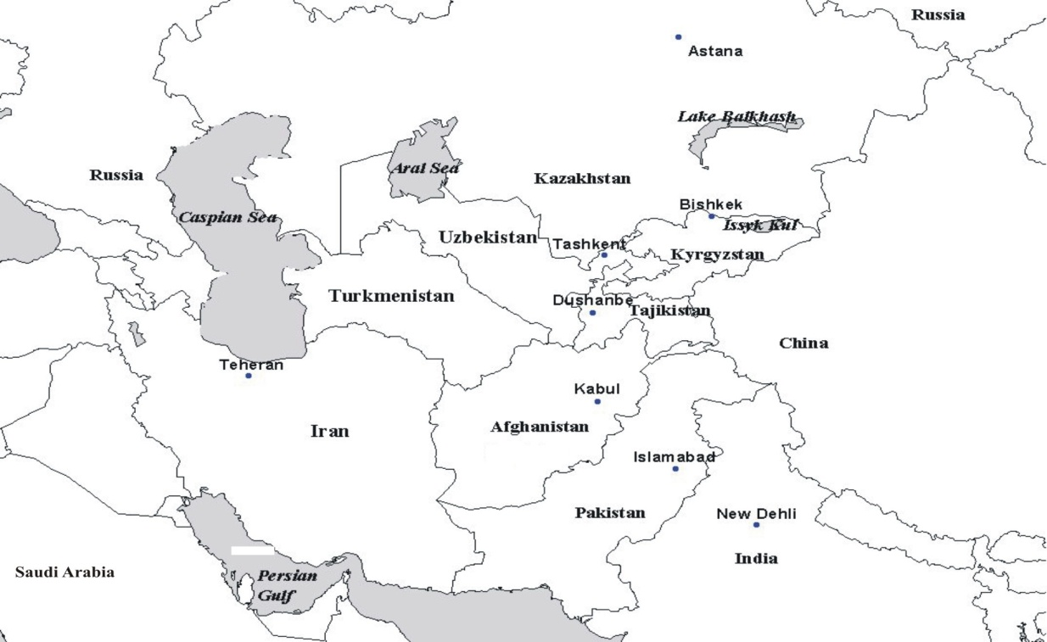
Konfliktfylt region
Notes:
India –Pakistan in conflict over Kashmir, using Afghanistan to pressure the other
Iran – shia connection in Afghanistan, potential international pressure from Afghanistan and Iraq
stans, weak human rights records, Islamic groups linked to different Afghan parties and Al Qaida
A growing competion over natural resources in Central Asia, China with increased interest, Russia to protect old interests
Islam, confrintation between shia/sunni (especially in Pakistan), wahabisme (incl Central Asia), and the influence of Al Qaida

Slide 4
Tidslinje & område & styrkar
Terror OEF Bonn/ISAF NATO PRT ISAF + ORF (USA)
11/09/01 7/10/01 20/12/01 11/08/03 13/10/03 31/06/06
5 “regional commands” – nord (Tyskland); vest (Italia); “capital” (Frankrike); sør (Nederland) og aust (USA)
ISAF – 43 nasjonar, 71 030 troppar, 26 PRTar, request: 40 000 til
Norge ca 500 basert i nord + Kabul
ANA – 94 000 troppar ( til 134 000 i oktober 2010)

Slide 5
ISAF MANDAT
ISAF was deployed in 2001 under the authority of the UN Security Council (UNSC) which authorised the establishment of the force to assist the Afghan government “in the maintenance of security in Kabul and its surrounding areas, so that the Afghan Interim Authority as well as the personnel of the United Nations can operate in a secure environment.”
ISAF is a coalition of the willing - not a UN force properly speaking - which has a peace-enforcement mandate under Chapter VII of the UN Charter.
A detailed Military Technical Agreement agreed between the ISAF Commander and the Afghan Transitional Authority in January 2002 provides additional guidance for ISAF operations.

Slide 6
ISAF ARBEIDSOMRÅDE
Security
Conducting security and stability operations
Supporting the Afghan National Army
Supporting the Afghan National Police
Facilitating ammunition depots managements
Providing post-operation assistance
Reconstruction and development (PRT)
Providing security to permit reconstruction
Humanitarian Assistance
Governance
Counter-narcotics

Slide 7
NATO MANDAT
NATO’s main role in Afghanistan is to assist the Afghan Government in exercising and extending its authority and influence across the country, paving the way for reconstruction and effective governance.
It does this predominately through its UN-mandated International Security Assistance Force.

Slide 8
OPERATION ENDURING FREEDOM (OEF)
The presence of actors operating under US-led OEF is defined in a bi-lateral agreement between participating actors and the GoA of May 2005.
The Coalition is referred to in UNSCR 1510 (2003) and subsequent Resolutions, which call for ISAF to work with OEF in the implementation of both forces’ mandates.

Slide 9
PROVINCIAL RECONSTRUCTION TEAM
PRT jobber med å kartlegge samfunnene i provinsene, vise tilstedeværelse og informere lokalbefolkningen om valg og andre viktige hendelser.
PRTs hovedfunksjon er å understøtte det valgte sentralstyret i Kabul, den afghanske nasjonale hæren (ANA) og det afghanske nasjonale politiet (ANP) og å bistå disse i utviklingen av provinsene.
PRT er også en viktig institusjon i arbeidet for avvæpning av illegale bevæpnede grupper, identifisering av narkotikavirksomhet og svekkelse av makten til regionale krigsherrer.

Slide 10
Notes:
An internationally divided country with a large variety of hum/ development strategies and degree of military involvement in these

Slide 11
AF/PAK status
I Afghanistan
Taliban har defacto kontroll – om ikkje permanent – over store deler av sør og søraust Afghanistan.
Utfordrar den Afghanske regjeringa, ISAF/OEF/NATO og Afghansk hær og politi.
Har satt opp eigne lokaladministrasjonar og justisvesen i enkelte provinsar
Utføre målretta sjølvmordangrep i Kabul, større aktivitet i nord Afghanistan
I Pakistan
Taliban opererar primært frå grense/stammeområdet mot Afghanistan, der også Al Qaida har hatt treningsleirar – den Pakistanske hæren gjennomføre angrep
Ansvarleg for ei rekke bombeangrep, drap av stammeleiarar og sentral personar, inkludert anklaga for drap på statsminister Bhutto. USA bruker droner for å drepe Taliban og Al Qaida ledarar – terrordiskusjon i Pakistan
Taliban kontrollerte SWAT dalen i ein begrensa tidsperiode, framleis uro

Slide 12
Afghanistan
25 -30 million inhabitants, 80 % sunni Muslims
Never (fully) colonialised, buffer-zone between the British and Russian empire, arena for the Cold War and the War on Terror
Pashtuns : majority ethnic group and historically King/President
One of the world’s 3 least developed countries, but the world’s major producer of opium
25 % of the population returned since 2001, major conflicts over land, property and water
Elections for President and Provincial Councils in 2009 - flawed

Slide 13
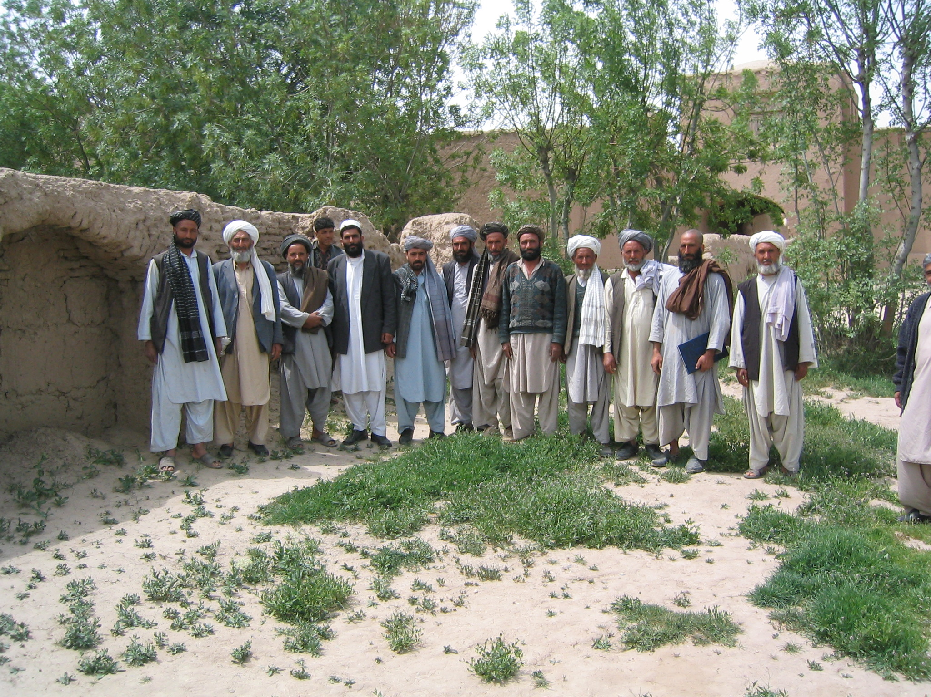
Notes:
The village council is important for conflict and resource management, and for development planning. Consensus oriented – all male. The tribes use jirgas to solve conflicts within and between tribes, and the national Loya Jirga has been used to appoint Kings/Presidents and approve constitutions.

Slide 14
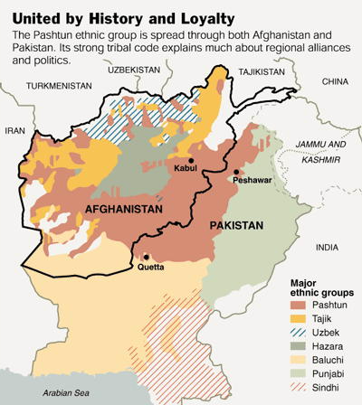
Notes:
The Brits divided pashtuns through the Durrand line, a border Afghanistan has not yet recgnised

Slide 15
PASHTUN PRIDE
http://www.youtube.com/watch?v=fet5tDxxsc4
Notes:
2 min – pashtuns joined in their defence of their homeland in both countries

Slide 16
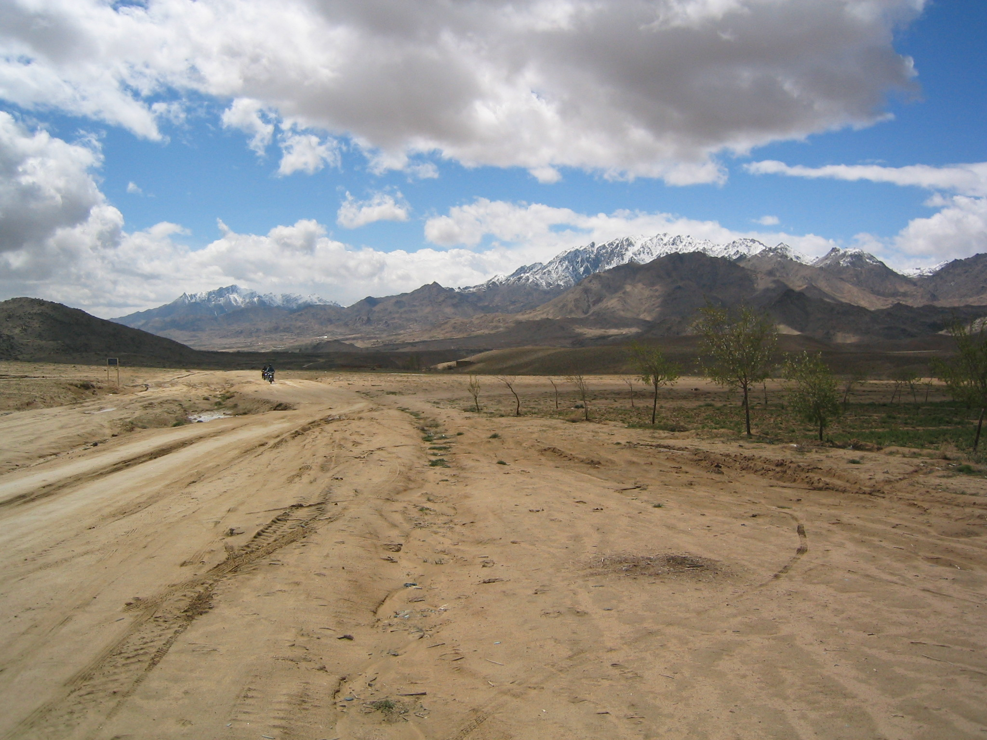
Notes:
Jagori, Ghazni province, bording pashtuns and hazaras

Slide 17
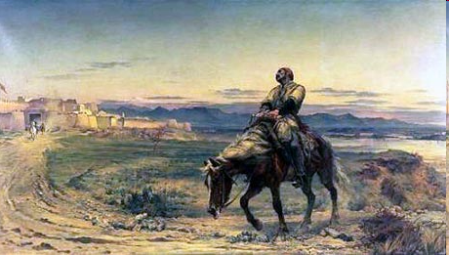
Dr. Byron - 1842
Notes:
The classic picture of british defeat in Afghanistan, the only survivor of the retreat from Kabul reaches Jalalabad – used to mobilise military against British forces in south Afghanistan

Slide 18
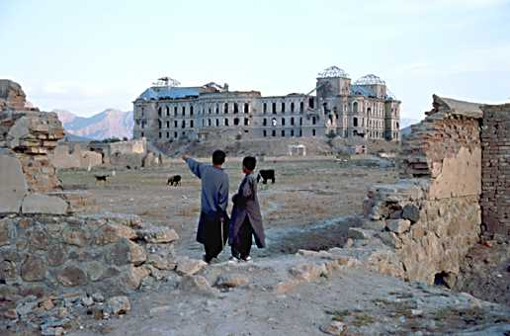
PDPA coup de etait1978
Notes:
PDPA’s attempt to improve education and include girls, undertake a land reform, ban forced/organised marriages etc met religious and armed resistance

Slide 19
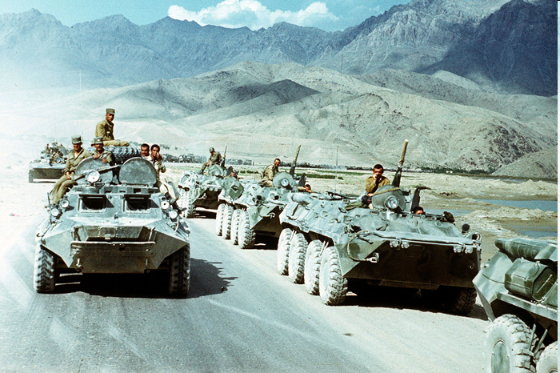
Sovjet invasjon 1979 – 89
Notes:
As internal differenced was about to derail the Afghan revolution (and kill off the PDPA) the Sovietunion decided to invade – with a repsonse from ”the west” to support Afghans to fight communism and from the Muslim world to fight ateism, channeled primarily through 7 Afghan Islamic parties based in Pakistan – while some shia parties operated from Iran

Slide 20
Building Islamic resistance – from Pakistan
International military support for 7 Afghan Islamic mujahedeen parties, through Pakistan and the ISI
Cofunding – Saudi matched every US dollar – in a fight against communism and atheism
Military training camps established along the Afghan border – some ”refugee camps” bases for the political parties
Madrassas established to house mujahedeen children
Islamic fighters welcome, Al Qaida – the Base – established in Peshawar as a logistic/funding centre
AN AFGHAN ”FIGHTIG ELITE” IN PAKISTAN – AND MORE INDEPENDENT FRONTS INSIDE AFGHANISTAN

Slide 21
Krigen om Kabul – 1992-95
Notes:
With US withdrawal of financial support in 1991, and later Saudi Arabia, the country ended in internal and often ethnic based struggle and massacres. Tadjiks and pashtuns joined forces in Kabul to oust hazaras, city largely destroyed and country divided between commanders – caos, robbery and localised war that forced people to flee

Slide 22
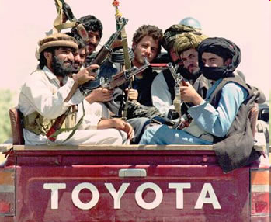
Taliban 1994-2001 – pashtunsk hevn
Notes:
Emerging as a group that took on local commanders in Kanadahar that had raped women, they quicly received local support – including from traders – and expanded their muilitary and religious control through the local mullahs. Their rule generally accepted in rural/pashtin areas, not so in the more multhiethnic cities and when they took control over areas primarily inhabited by other ethnic groups.

Slide 23
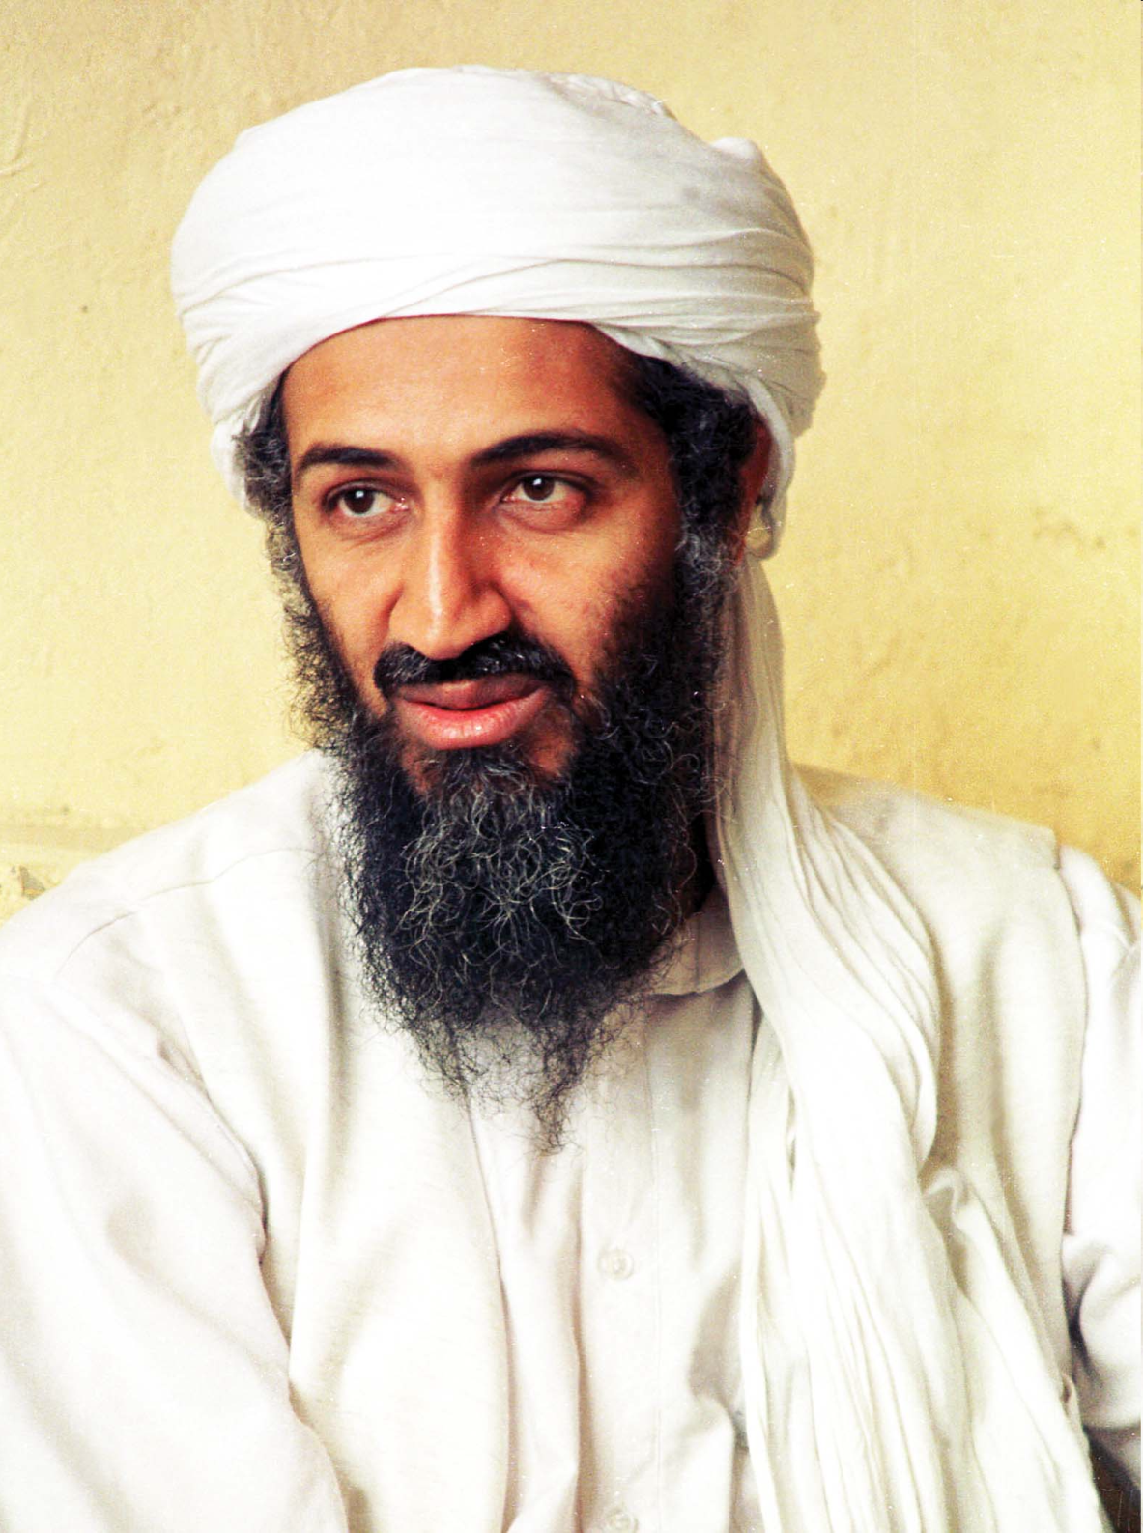
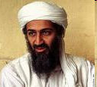
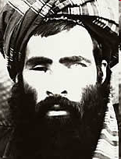
Litt etter kvart: Taliban + Al Qaida
Notes:
Bin Laden fought with the Islamist Afghan parties during the 1990s, returned from Sudan to live in areas controlled by the then Rabbani government. Fled from Jalalabad when Taliban took over the area as they had promised to weed out all wahabis. Later reconciled, and when UN imposed sanctions on Afghanistan the more moderate elements within Taliban lost out to those leaning more towards Al Qaida (and their funding).

Slide 24
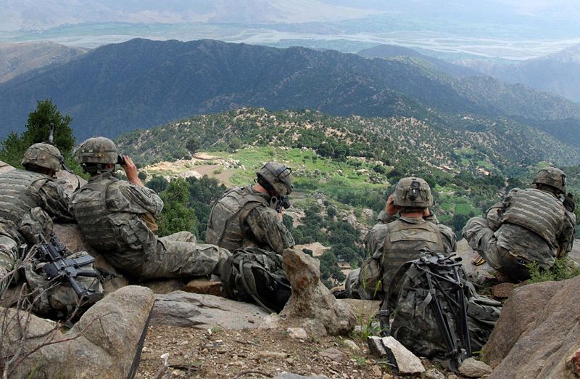
2001 – internasjonale styrkrar + ethniske minoritetar = Bonn avtale
Notes:
Operation Enduring Freedom – US joined hands with the minority groups, Taliban moved back into the villages, tadjiks into Kabul – amd aliban excluded from the negotiations in Bonn that laid the frame for the democration process.

Slide 25
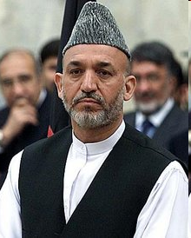
A Pashtun president

Slide 26
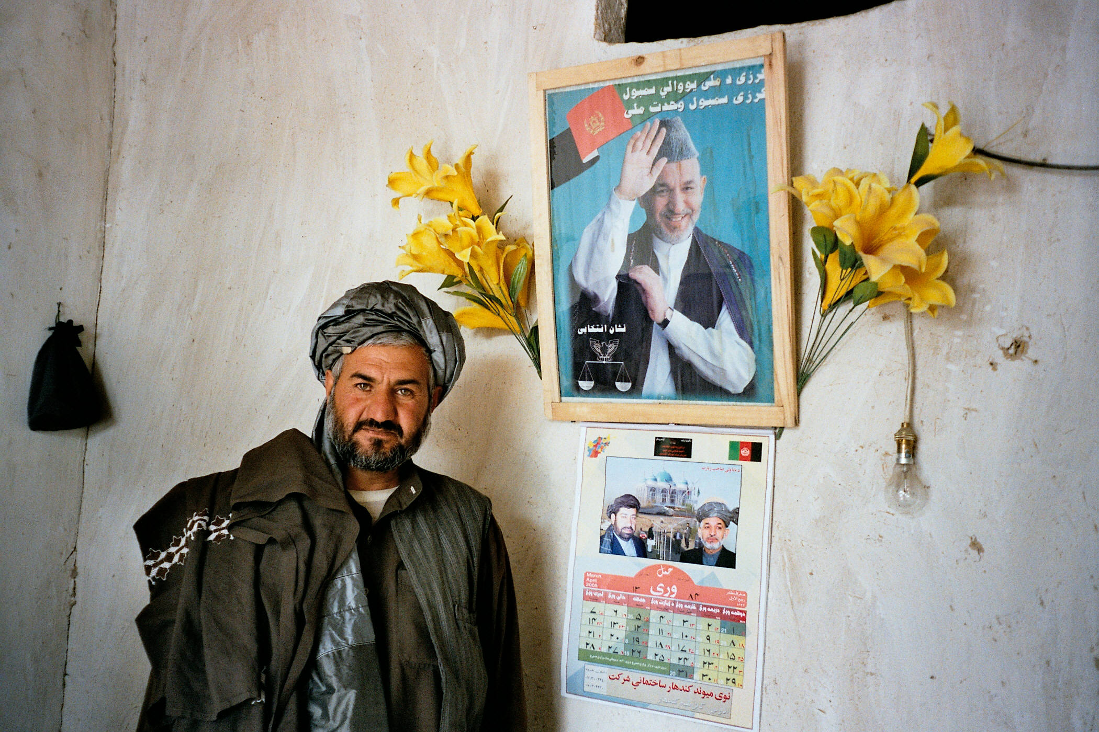
Stabilize = Cooptation
Notes:
With a cooptation stratgy applied by Karzai, supported by the US and UN, party/tribal connections became more important than competence for central government positions.

Slide 27
Human Development Report 2008 – a distrusted judicial system
Less than 20% of disputes are currently settled through the
state court system in Afghanistan.
80% of cases are settled through traditional justice bodies.
Percentages drawn from Asia Foundation (2006) and “Justice for All” (2005).
Notes:
A vital foundation for statebuilding is lacking – as is the trust in the Afghan govrnment

Slide 28
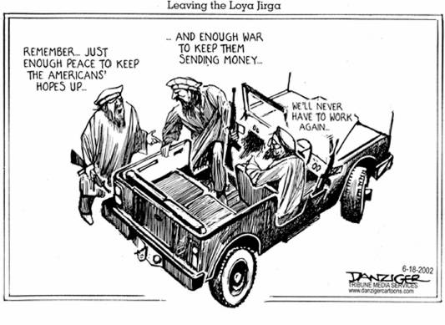

Slide 29
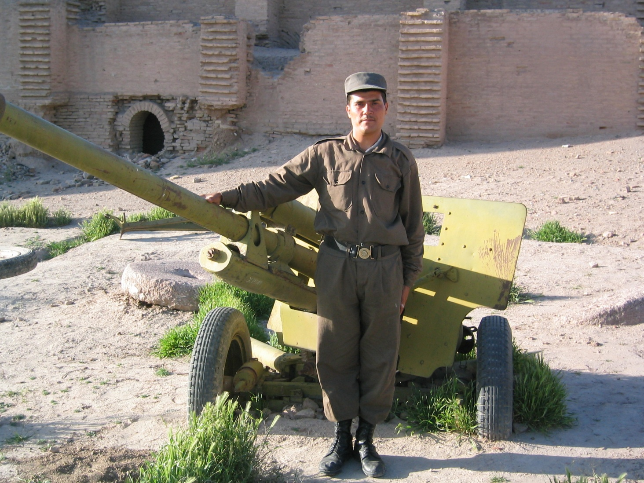
Notes:
While the Afghan National Army has been reformed, the police often recruited a commander + his soldiers to join + weak training – cops or robbers?

Slide 30
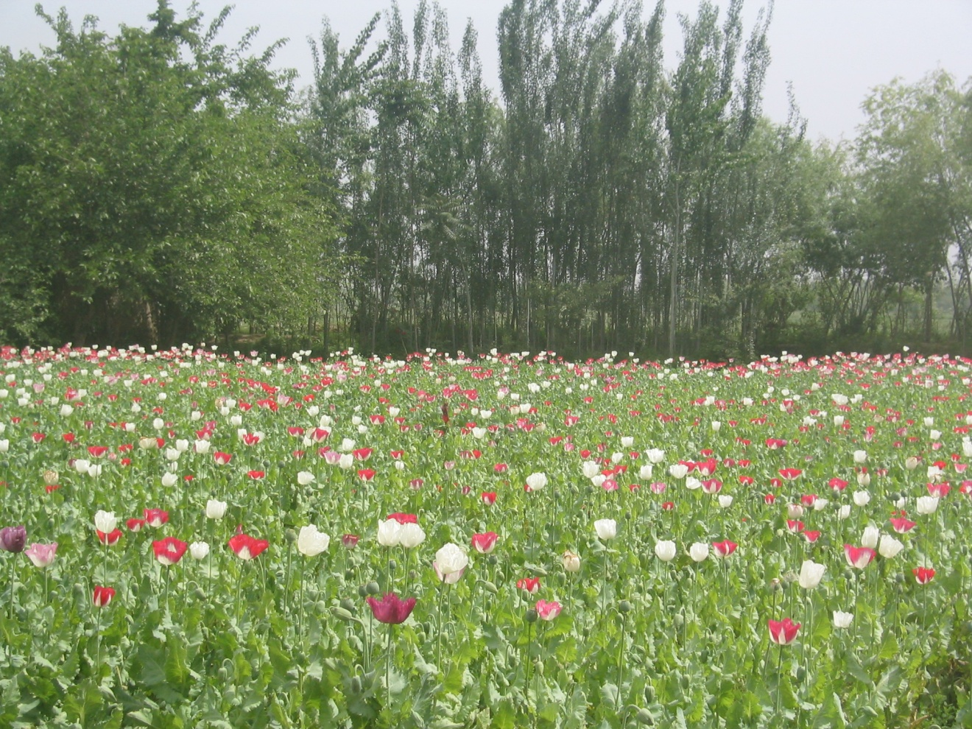
Notes:
A major income for government officials, police and the taliban – and poor farmers with few other income opportunities

Slide 31
Karzai: "There will definitely not be any drug thing in Afghanistan. We will be dedicated, strong, in working against that.“
(BBC 4 November 2004)

Slide 32
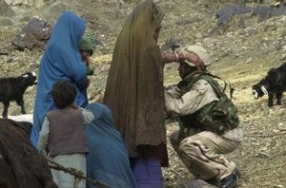

Slide 33
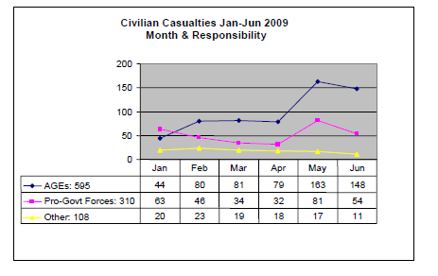
Sivile tap

Slide 34
Threats towards civilians (Oxfam 02.08)
Notes:
While the media focus on the threat towards international soldiers, primarilt attributed to the Taliban, the threats identified by the Afghan population is much more diverse (kills many more) and is not what the ISAF and OEF is primarily to protect them against

Slide 35
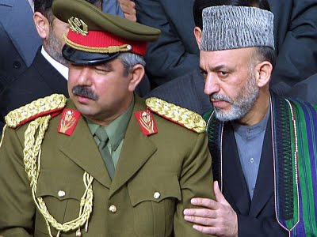
Legitimitet – etter presidentvalet

Slide 36
General McChrystal – COMISAF INITIAL ASSESSMENT
The population also represents a powerful actor that can and must be leveraged in this system. Gaining their support will require a better understanding of the people’s choices and needs.
However, progress is hindered the dual threat of a resilient insurgency and a crisis of confidence in the government and the international coalition.
To win their support, we must protect the people from both of these threats.
(30 August 2009)

Slide 37
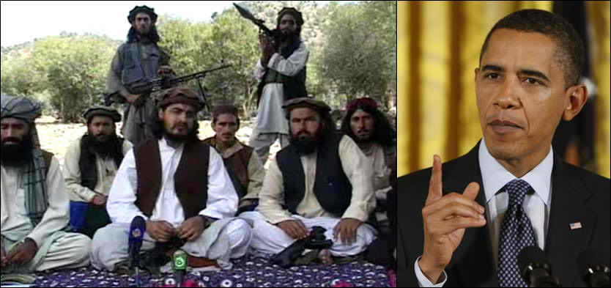
Fight or talk, and only to the ”moderates”?

Slide 38
Dei mange utfordringane
Militære og sivile tap aukar internasjonal og afghansk motstand
Valfjusk synleggjer manglande legitimitet for President Karzai og derav dei internasjonale styrkane
Erkjenning av at konflikten ikkje kan vinnast militært – men frykt for at uttrekning/forhandling vert nederlag ” if not from strength”
  Utrekning utan ny internkonflikt (ref norske PRT sjefar)?
  Fleire soldatar, meir sikkerheit eller fleire militære mål?
  Kvalitet og lojalitet på Afghansk hær/politi – og innretning
  Kan me akseptere ”the return of the Taliban”?
  Kan USA/UK soldatar erstattast med ie frå muslimske land?
  ARE YOU HERE TO PROTECT YOURSELF OR US?

Slide 39
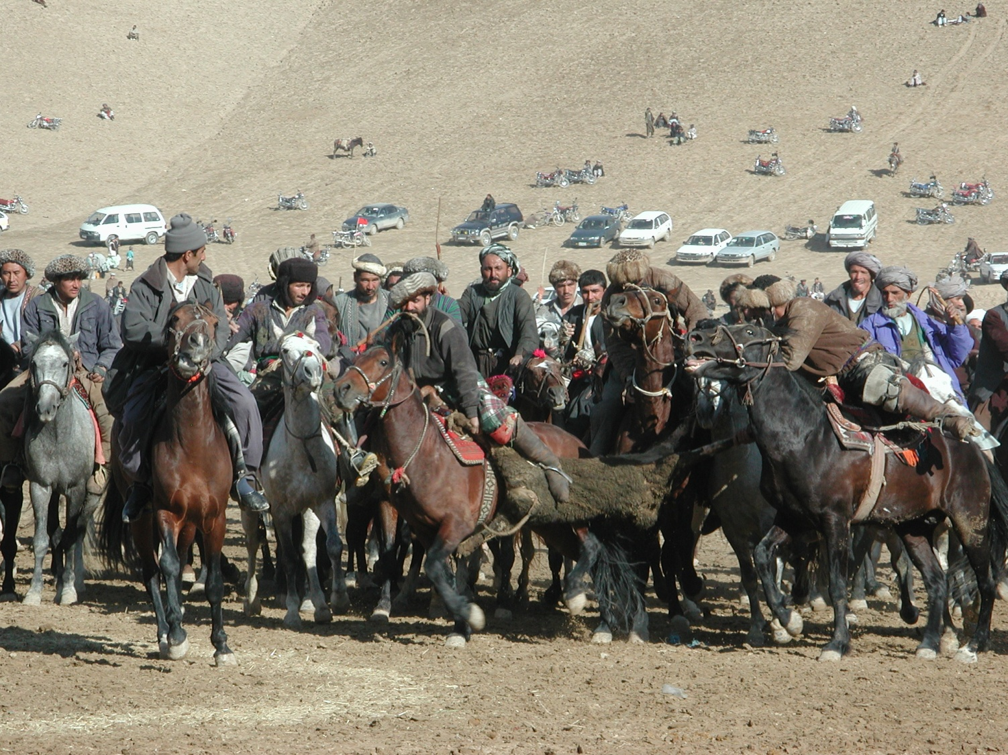
Notes:
Civilans – feeling like the goat pulled between the horemen used for the classic afghan game of Boskhash

